Slide 1
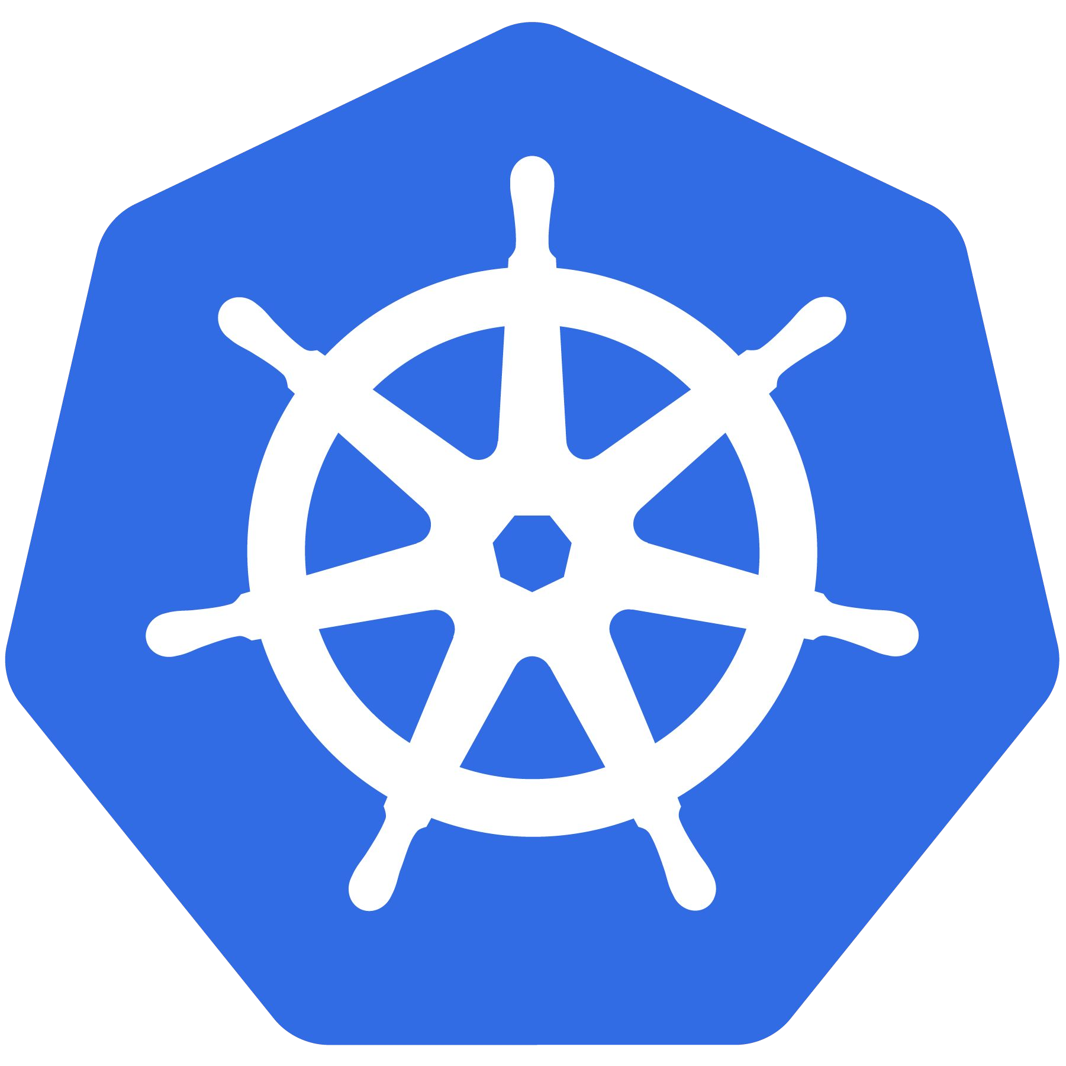
Kubernetes
An Introduction
CC-BY 4.0

Slide 2

Before We Begin
Requirements:
Minikube:
https://github.com/kubernetes/minikube
Virtualbox*:
https://www.virtualbox.org/wiki/Downloads
kubectl:
https://kubernetes.io/docs/tasks/tools/install-kubectl/
k8s-intro-tutorials repo:
https://github.com/mrbobbytables/k8s-intro-tutorials

Slide 3
Kubernetes
An Introduction
CC-BY 4.0

Slide 4
Project Overview

Slide 5
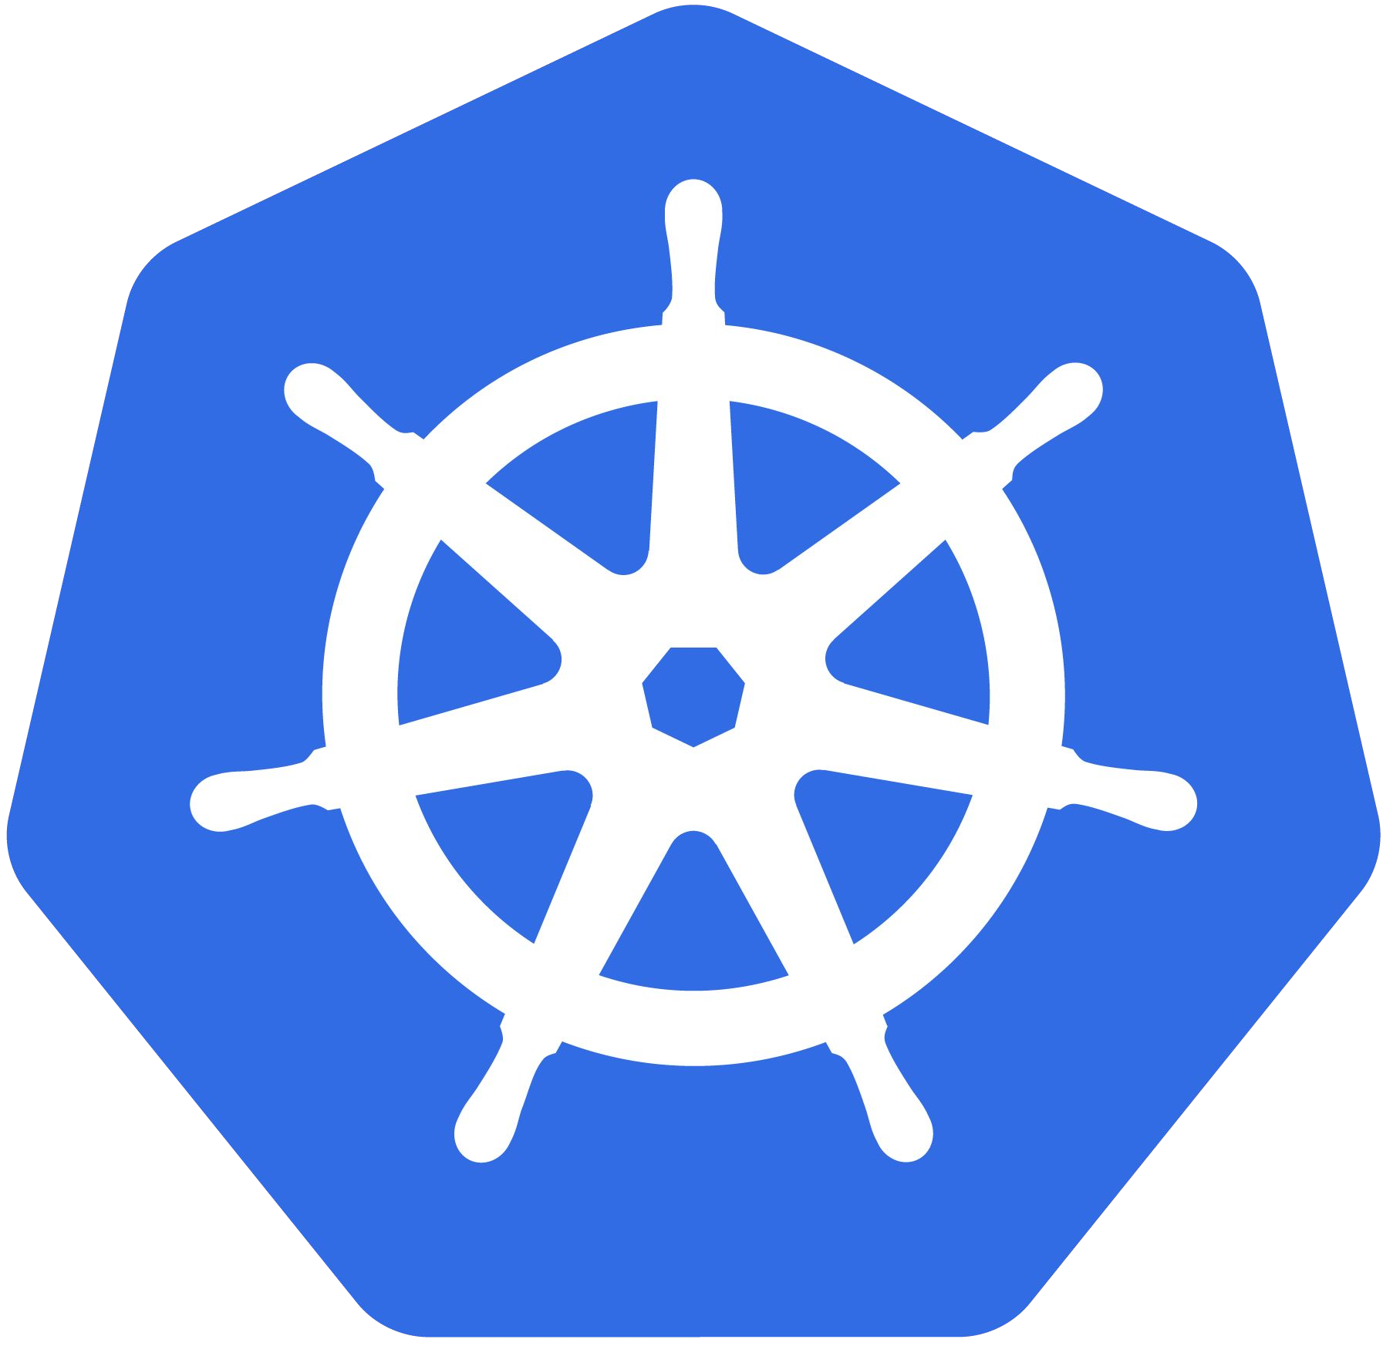

What Does “Kubernetes” Mean?
Greek for “pilot” or “Helmsman of a ship”
Image Source

Slide 6
What is Kubernetes?
Project that was spun out of Google as an open source container orchestration platform.
Built from the lessons learned in the experiences of developing and running Google’s Borg and Omega.
Designed from the ground-up as a loosely coupled collection of components centered around deploying, maintaining and scaling workloads.

Slide 7
What Does Kubernetes do?
Known as the linux kernel of distributed systems.
Abstracts away the underlying hardware of the nodes and provides a uniform interface for workloads to be both deployed and consume the shared pool of resources.
Works as an engine for resolving state by converging actual and the desired state of the system.

Slide 8
What can Kubernetes REALLY do?
Autoscale Workloads
Blue/Green Deployments
Fire off jobs and scheduled cronjobs
Manage Stateless and Stateful Applications
Provide native methods of service discovery
Easily integrate and support 3rd party apps

Slide 9

Who “Manages” Kubernetes?
The CNCF is a child entity of the Linux Foundation and operates as a vendor neutral governance group.

Slide 10

Project Stats
Over 38,000 stars on Github
1700+ Contributors to K8s Core
Most discussed Repository by a large margin
41,000+ users in Slack Team
07/2018

Slide 11
A Couple Key Concepts...

Slide 12
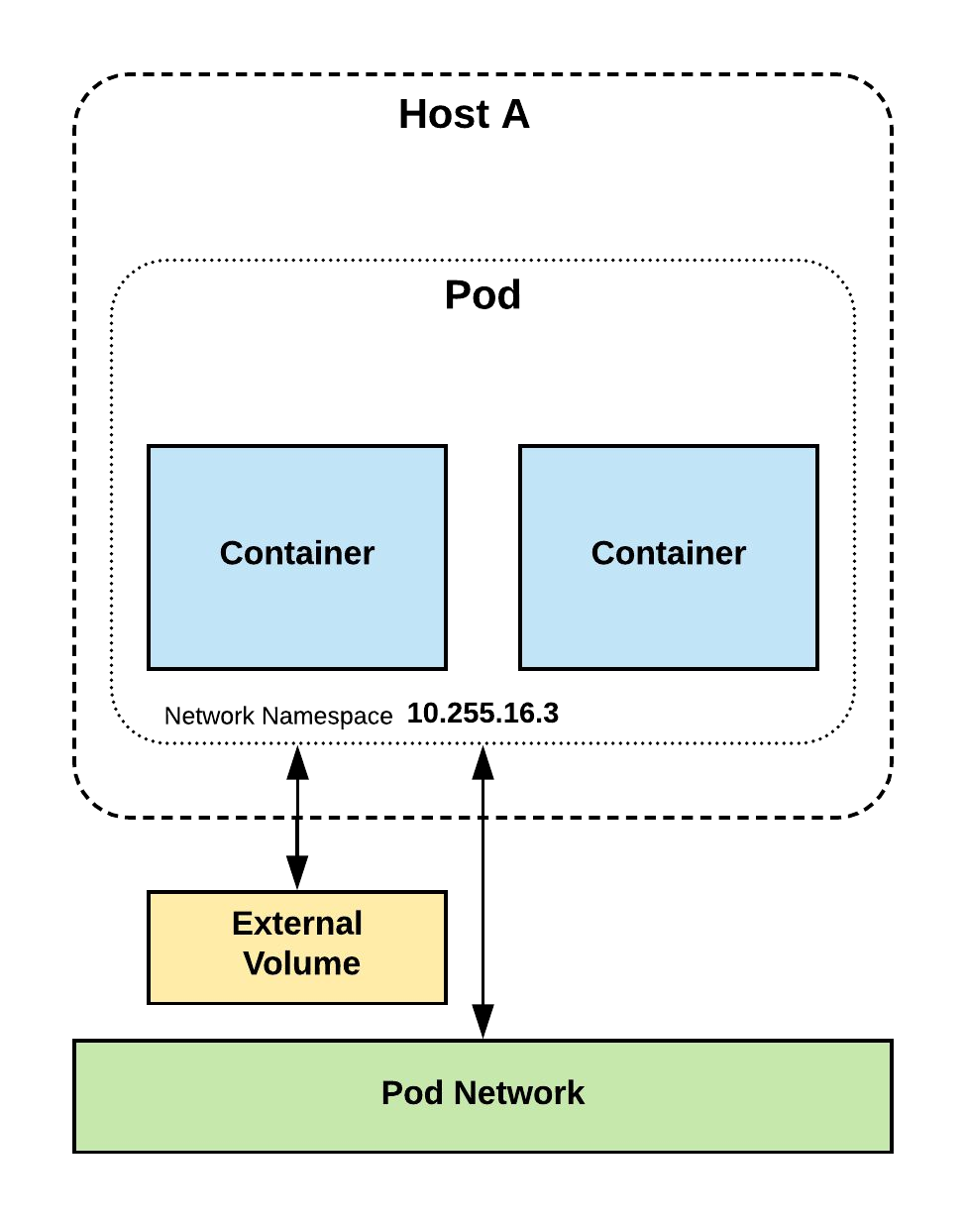
Pods
Atomic unit or smallest “unit of work”of Kubernetes.
Pods are one or MORE containers that share volumes, a network namespace, and are a part of a single context.

Slide 13
Pods
They are also Ephemeral!

Slide 14
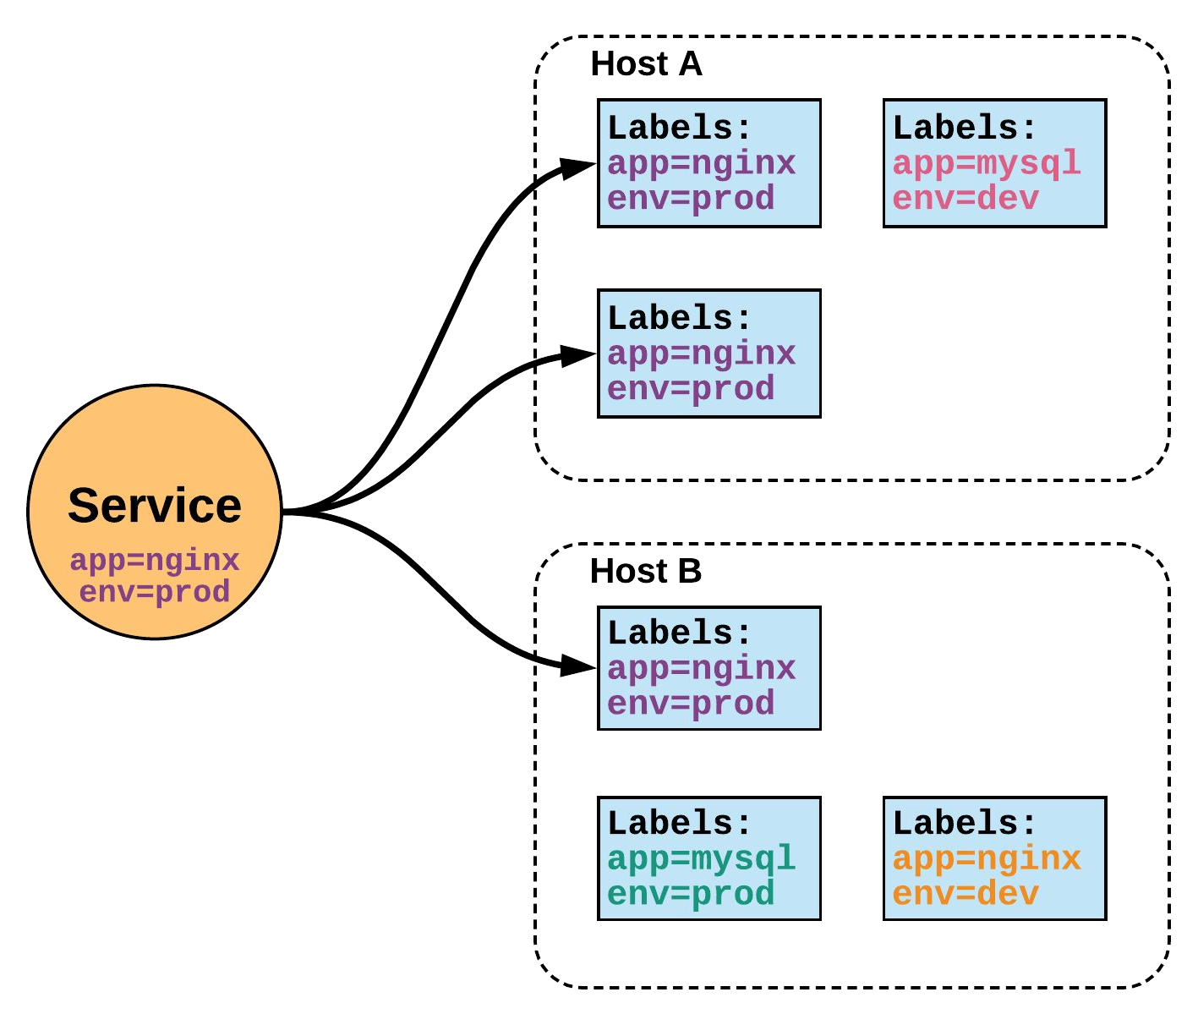
Services
Unified method of accessing
the exposed workloads of Pods.
Durable resource
static cluster IP
static namespaced DNS name

Slide 15
Services
Unified method of accessing
the exposed workloads of Pods.
Durable resource
static cluster IP
static namespaced DNS name
NOT Ephemeral!

Slide 16
Architecture Overview

Slide 17
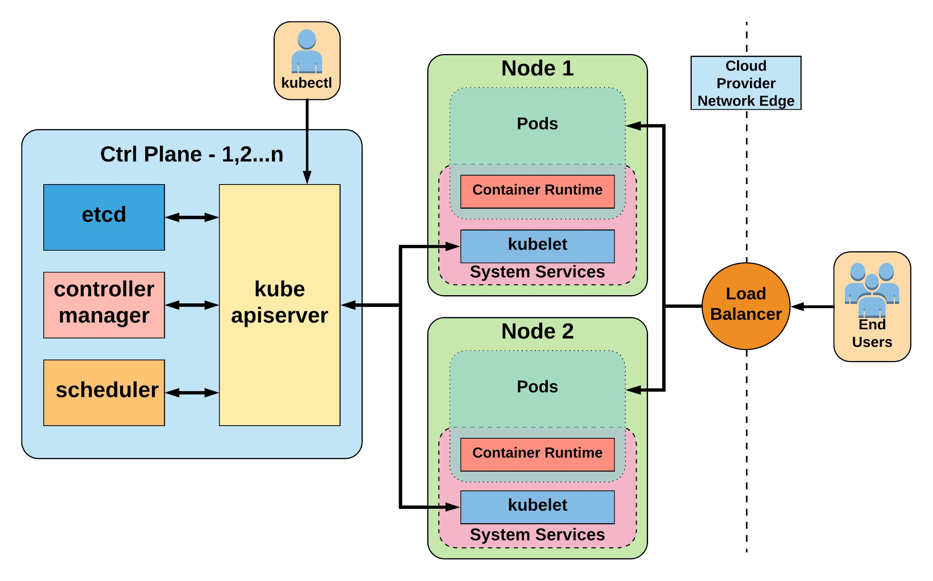


Slide 18

Control Plane Components
Architecture Overview

Slide 19
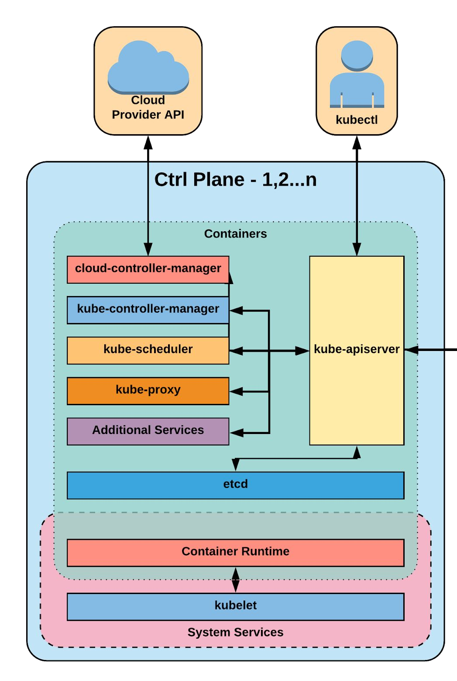
Control Plane Components
kube-apiserver
etcd
kube-controller-manager
kube-scheduler

Slide 20
kube-apiserver
Provides a forward facing REST interface into the kubernetes control plane and datastore.
All clients and other applications interact with kubernetes strictly through the API Server.
Acts as the gatekeeper to the cluster by handling authentication and authorization, request validation, mutation, and admission control in addition to being the front-end to the backing datastore.

Slide 21

etcd
etcd acts as the cluster datastore.
Purpose in relation to Kubernetes is to provide a strong, consistent and highly available key-value store for persisting cluster state.
Stores objects and config information.

Slide 22
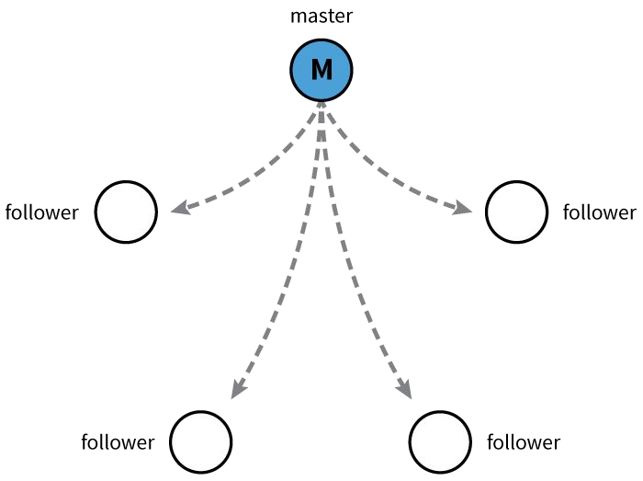
etcd
Uses “Raft Consensus” among a quorum of systems to create a fault-tolerant consistent “view” of the cluster.
https://raft.github.io/
Image Source

Slide 23
kube-controller-manager
Serves as the primary daemon that manages all core component control loops.
Monitors the cluster state via the apiserver and steers the cluster towards the desired state.
List of core controllers:
https://github.com/kubernetes/kubernetes/blob/master/cmd/kube-controller-manager/app/controllermanager.go#L332

Slide 24
kube-scheduler
Verbose policy-rich engine that evaluates workload requirements and attempts to place it on a matching resource.
Default scheduler uses bin packing.
Workload Requirements can include: general hardware requirements, affinity/anti-affinity, labels, and other various custom resource requirements.

Slide 25
Node Components
Architecture Overview

Slide 26
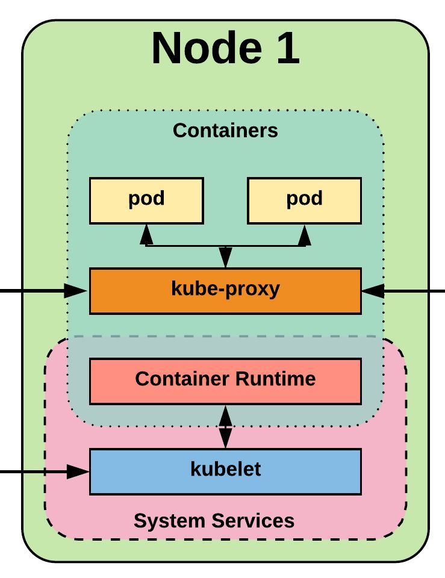
Node Components
kubelet
kube-proxy
Container Runtime Engine

Slide 27
kubelet
Acts as the node agent responsible for managing the lifecycle of every pod on its host.
Kubelet understands YAML container manifests that it can read from several sources:
file path
HTTP Endpoint
etcd watch acting on any changes
HTTP Server mode accepting container manifests over a simple API.

Slide 28
kube-proxy
Manages the network rules on each node.
Performs connection forwarding or load balancing for Kubernetes cluster services.
Available Proxy Modes:
Userspace
iptables
ipvs (beta in 1.9)

Slide 29
Container Runtime Engine
A container runtime is a CRI (Container Runtime Interface) compatible application that executes and manages containers.
Containerd (docker)
Cri-o
Rkt
Kata (formerly clear and hyper)
Virtlet (VM CRI compatible runtime)

Slide 30
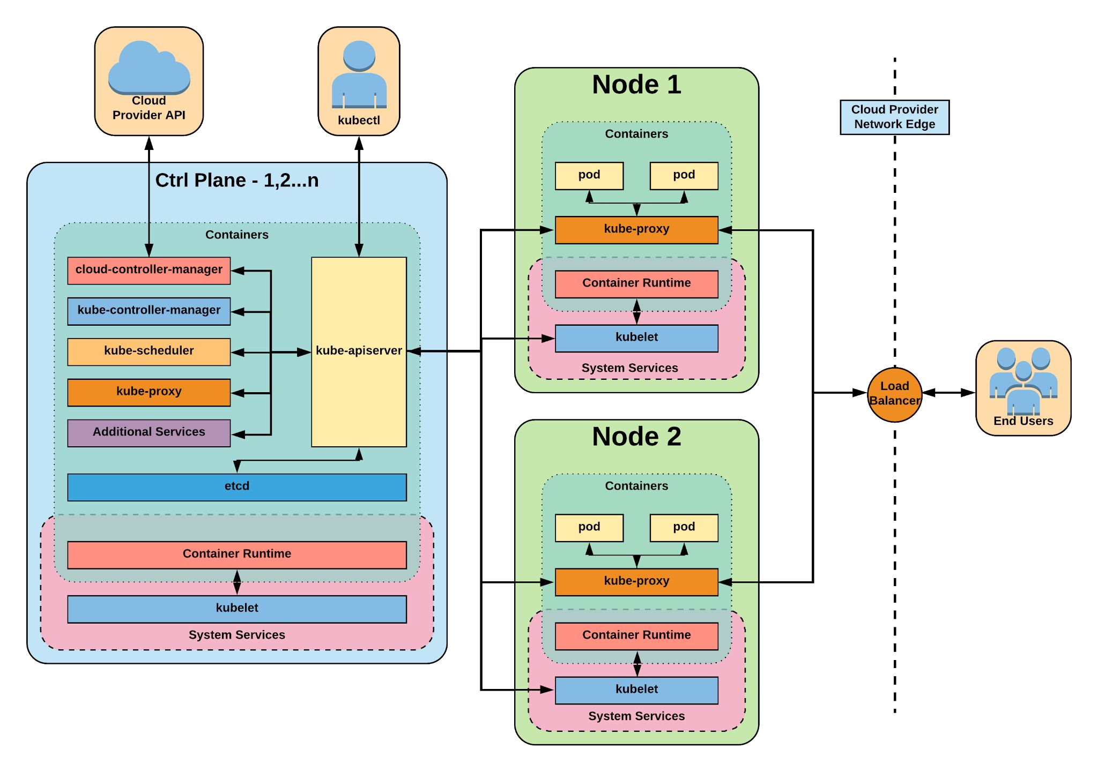

Slide 31
cloud-controller-manager
Daemon that provides cloud-provider specific knowledge and integration capability into the core control loop of Kubernetes.
The controllers include Node, Route, Service, and add an additional controller to handle things such as PersistentVolume Labels.

Slide 32
Cluster DNS
Provides Cluster Wide DNS for Kubernetes Services.
kube-dns (default 1.10)
CoreDNS (future default)

Slide 33
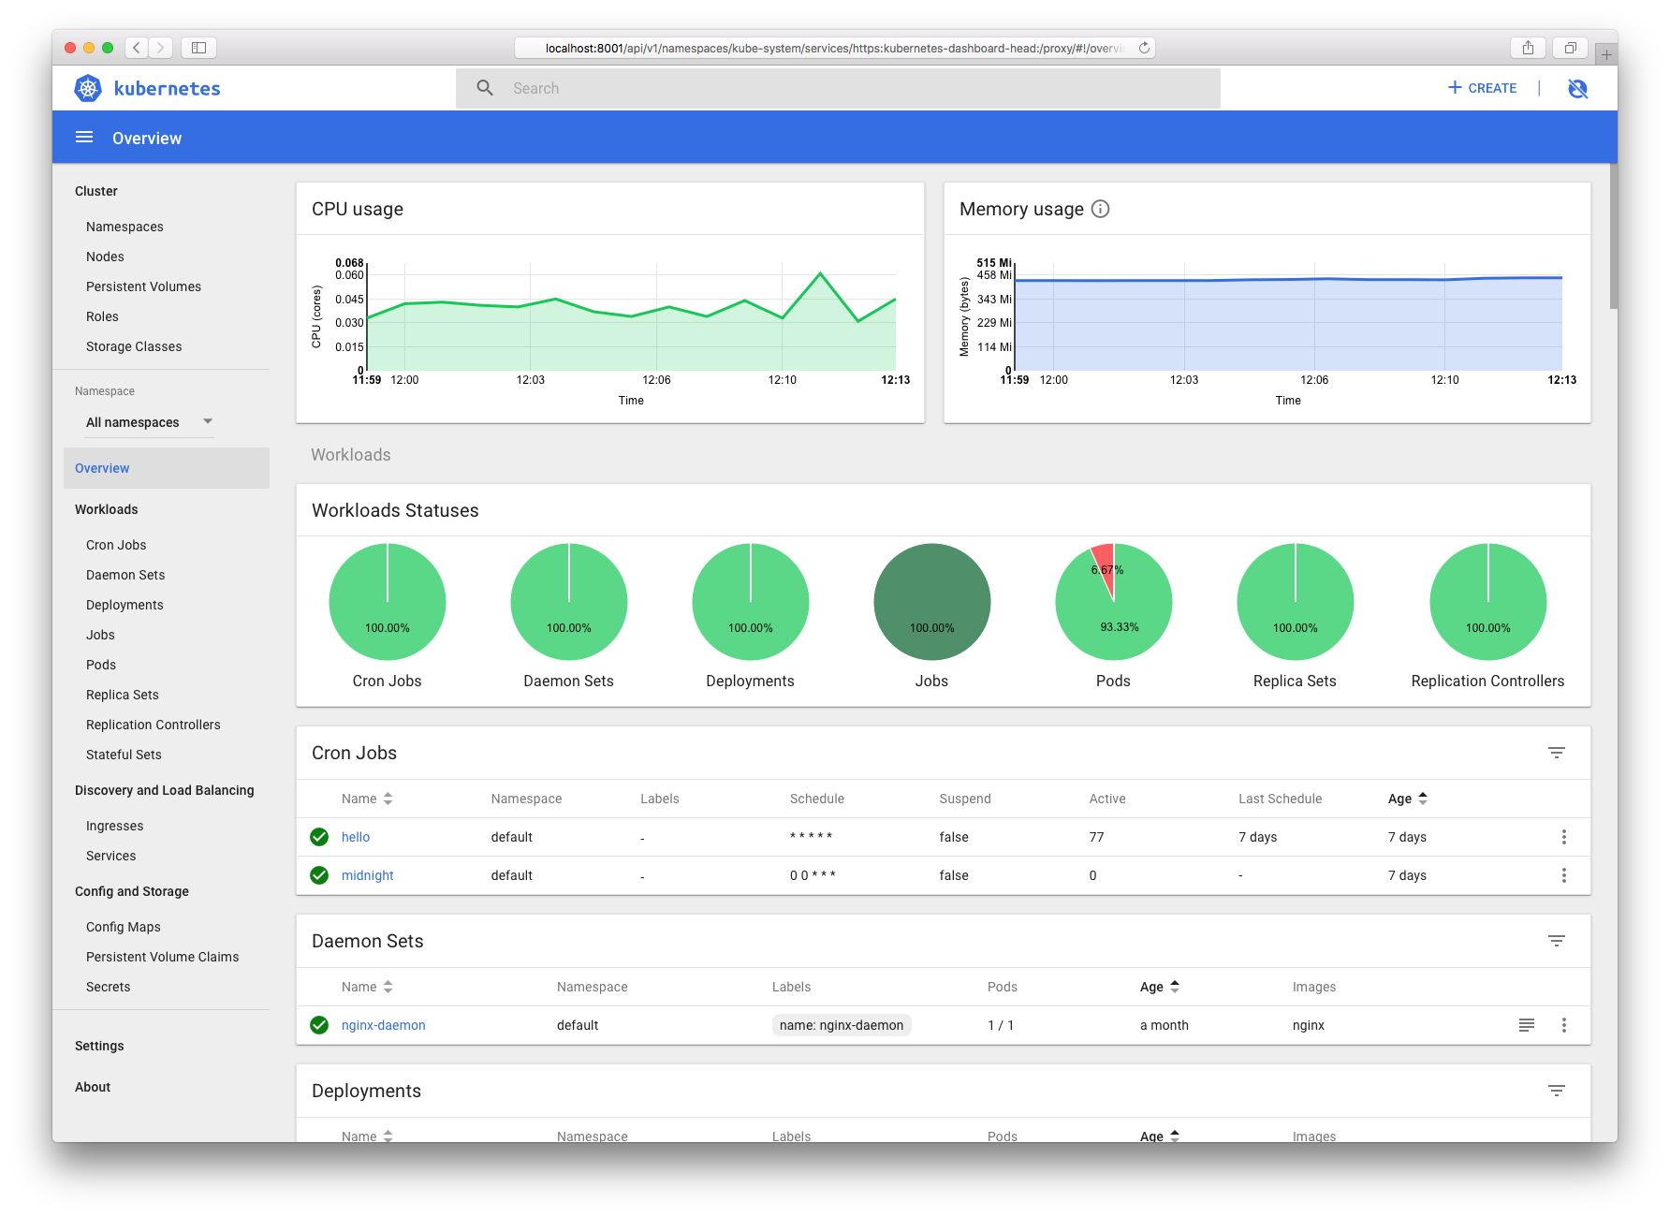
Kube Dashboard
A limited, general purpose web front end for the Kubernetes Cluster.

Slide 34
Heapster / Metrics API Server
Provides metrics for use with other Kubernetes Components.
Heapster (being deprecated)
Metrics API (current)

Slide 35
Kubernetes Networking
Pod Network
Cluster-wide network used for pod-to-pod communication managed by a CNI (Container Network Interface) plugin.
Service Network
Cluster-wide range of Virtual IPs managed by
kube-proxy for service discovery.

Slide 36

Container Network Interface (CNI)
Pod networking within Kubernetes is plumbed via the Container Network Interface (CNI).
Functions as an interface between the container runtime and a network implementation plugin.
CNCF Project
Uses a simple JSON Schema.

Slide 37
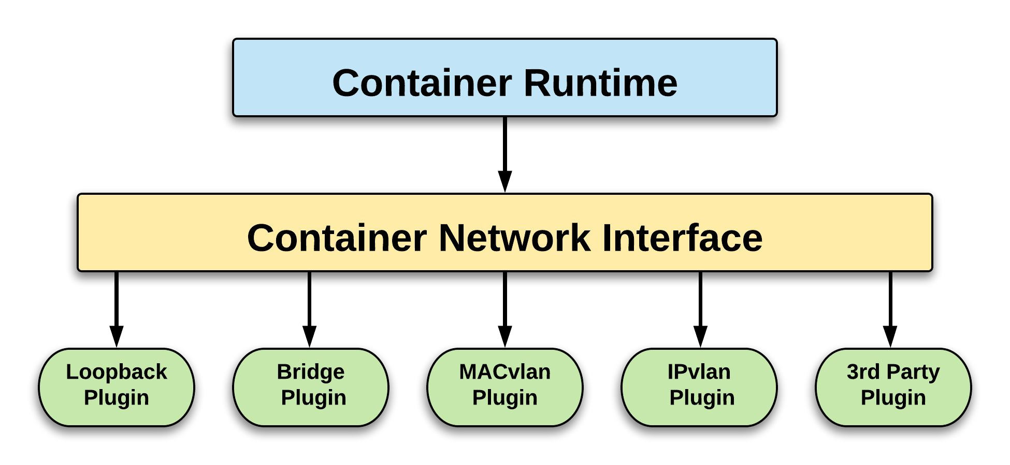
CNI Overview

Slide 38
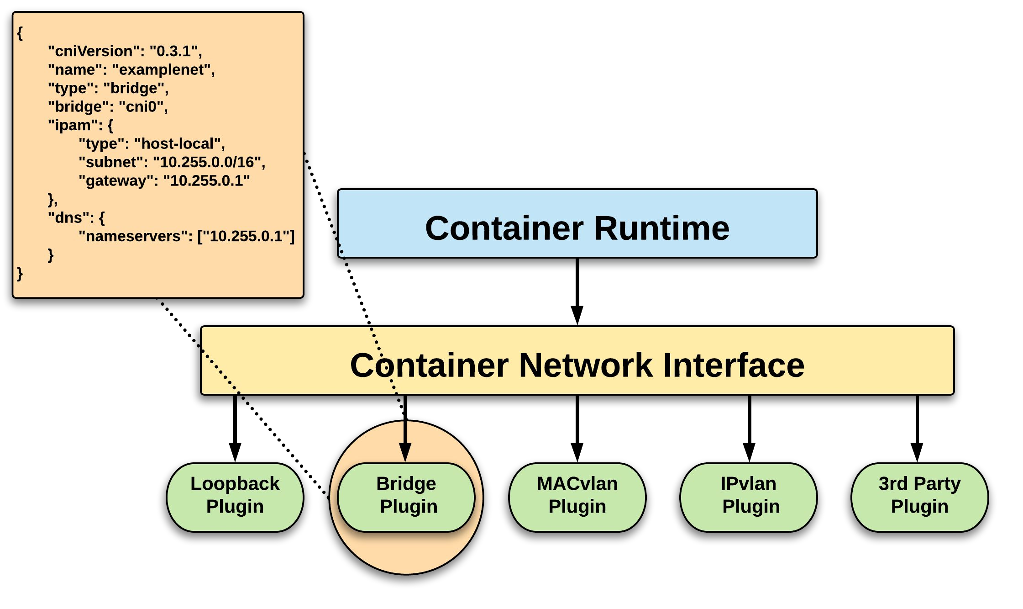
CNI Overview

Slide 39












CNI Plugins
Amazon ECS
Calico
Cillium
Contiv
Contrail
Flannel
GCE
kube-router
Multus
OpenVSwitch
Romana
Weave

Slide 40
Fundamental Networking Rules
All containers within a pod can communicate with each other unimpeded.
All Pods can communicate with all other Pods without NAT.
All nodes can communicate with all Pods (and vice-versa) without NAT.
The IP that a Pod sees itself as is the same IP that others see it as.

Slide 41
Fundamentals Applied
Container-to-Container
Containers within a pod exist within the same network namespace and share an IP.
Enables intrapod communication over localhost.
Pod-to-Pod
Allocated cluster unique IP for the duration of its life cycle.
Pods themselves are fundamentally ephemeral.

Slide 42
Fundamentals Applied
Pod-to-Service
managed by kube-proxy and given a persistent cluster unique IP
exists beyond a Pod’s lifecycle.
External-to-Service
Handled by kube-proxy.
Works in cooperation with a cloud provider or other external entity (load balancer).

Slide 43

API Overview
The REST API is the true keystone of Kubernetes.
Everything within the Kubernetes is as an API Object.
Image Source

Slide 44
API Groups
Designed to make it extremely simple to both understand and extend.
An API Group is a REST
Format:
/apis/<group>/<version>/<resource>
Examples:
/apis/apps/v1/deployments
/apis/batch/v1beta1/cronjobs
compatible path that acts as the type descriptor for a Kubernetes object.
Referenced within an object as the apiVersion and
kind.

Slide 45
API Versioning
Three tiers of API maturity levels.
Also referenced within the object apiVersion.
Format:
/apis/<group>/<version>/<resource>
Examples:
/apis/apps/v1/deployments
/apis/batch/v1beta1/cronjobs
Alpha: Possibly buggy, And may change. Disabled by default.
Beta: Tested and considered stable. However API Schema may change. Enabled by default.
Stable: Released, stable and API schema will not change.
Enabled by default.

Slide 46
Object Model
Objects are a “record of intent” or a persistent entity that represent the desired state of the object within the cluster.
All objects MUST have apiVersion, kind, and poses the nested fields metadata.name, metadata.namespace, and metadata.uid.

Slide 47
Object Model Requirements
apiVersion: Kubernetes API version of the Object
kind: Type of Kubernetes Object
metadata.name: Unique name of the Object
metadata.namespace: Scoped environment name that the object belongs to (will default to current).
metadata.uid: The (generated) uid for an object.
apiVersion: v1 kind: Pod metadata:
name: pod-example namespace: default
uid: f8798d82-1185-11e8-94ce-080027b3c7a6

Slide 48
Object Expression - YAML
Files or other representations of Kubernetes Objects are generally represented in YAML.
A “Human Friendly” data serialization standard.
Uses white space (specifically spaces) alignment to denote ownership.
Three basic data types:
mappings - hash or dictionary,
sequences - array or list
scalars - string, number, boolean etc

Slide 49
Object Expression - YAML
apiVersion: v1 kind: Pod metadata:
name: yaml spec:
containers:
name: container1 image: nginx
name: container2 image: alpine

Slide 50
Object Expression - YAML
apiVersion: v1 kind: Pod
metadata: name: yaml
spec: containers: name: container1 image: nginx name: container2 image: alpine
Scalar
Mapping Hash Dictionary
Sequence Array List

Slide 51
YAML vs JSON
apiVersion: v1 kind: Pod metadata:
name: pod-example spec:
containers:
- name: nginx
image: nginx:stable-alpine ports:
- containerPort: 80
{
"apiVersion": "v1",
"kind": "Pod", "metadata": {
"name": "pod-example"
},
"spec": { "containers": [
{
"name": "nginx",
"image": "nginx:stable-alpine", "ports": [ { "containerPort": 80 } ]
}
]
}
}

Slide 52
Object Model - Workloads
Workload related objects within Kubernetes have an additional two nested fields spec and status.
spec - Describes the desired state or
configuration of the object to be created.
status - Is managed by Kubernetes and describes the actual state of the object and its history.

Slide 53
Workload Object Example
Example Object
apiVersion: v1 kind: Pod metadata:
name: pod-example spec:
containers:
- name: nginx
image: nginx:stable-alpine ports:
- containerPort: 80
Example Status Snippet
status: conditions:
lastProbeTime: null
lastTransitionTime: 2018-02-14T14:15:52Z status: "True"
type: Ready
lastProbeTime: null
lastTransitionTime: 2018-02-14T14:15:49Z status: "True"
type: Initialized
lastProbeTime: null
lastTransitionTime: 2018-02-14T14:15:49Z status: "True"
type: PodScheduled

Slide 54
Namespaces
Pods
Labels
Selectors
Services
Core Objects
Concepts and Resources

Slide 55
Core Concepts
Kubernetes has several core building blocks that make up the foundation of their higher level components.
Namespaces
Pods Labels
Services Selectors

Slide 56
Namespaces
Namespaces are a logical cluster or environment, and are the primary method of partitioning a cluster or scoping access.
apiVersion: v1 kind: Namespace metadata:
name: prod labels:
app: MyBigWebApp
$ kubectl get ns --show-labels NAME STATUS AGE
default Active 11h kube-public Active 11h kube-system Active 11h prod Active 6s
LABELS
<none>
<none>
<none> app=MyBigWebApp

Slide 57
Default Namespaces
default: The default namespace for any object without a namespace.
kube-system: Acts as
the home for objects and resources created by Kubernetes itself.
kube-public: A special namespace; readable by all users that is reserved for cluster bootstrapping and configuration.
$ kubectl get ns --show-labels NAME STATUS AGE |  |  | LABELS
default | Active | 11h | <none>
kube-public | Active | 11h | <none>
kube-system | Active | 11h | <none>

Slide 58
Pod
Atomic unit or smallest “unit of work”of Kubernetes.
Foundational building block of Kubernetes Workloads.
Pods are one or more containers that share volumes, a network namespace, and are a part of a single context.

Slide 59
Pod Examples
apiVersion: v1 kind: Pod metadata:
name: pod-example spec:
containers:
- name: nginx
image: nginx:stable-alpine ports:
- containerPort: 80
apiVersion: v1 kind: Pod metadata:
name: multi-container-example spec:
containers:
name: nginx
image: nginx:stable-alpine volumeMounts:
name: html
mountPath: /usr/share/nginx/html
name: content
image: alpine:latest command: ["/bin/sh", "-c"] args:
- while true; do
date >> /html/index.html; sleep 5;
done volumeMounts:
name: html mountPath: /html
volumes:
name: html emptyDir: {}

Slide 60
Key Pod Container Attributes
name - The name of the container
image - The container image
ports - array of ports to expose. Can be granted a friendly name and protocol may be specified
env - array of environment variables
command - Entrypoint array (equiv to Docker ENTRYPOINT)
args - Arguments to pass to the command (equiv to Docker CMD)
Container
name: nginx
image: nginx:stable-alpine ports:
containerPort: 80 name: http protocol: TCP
env:
name: MYVAR value: isAwesome
command: [“/bin/sh”, “-c”]
args: [“echo ${MYVAR}”]

Slide 61
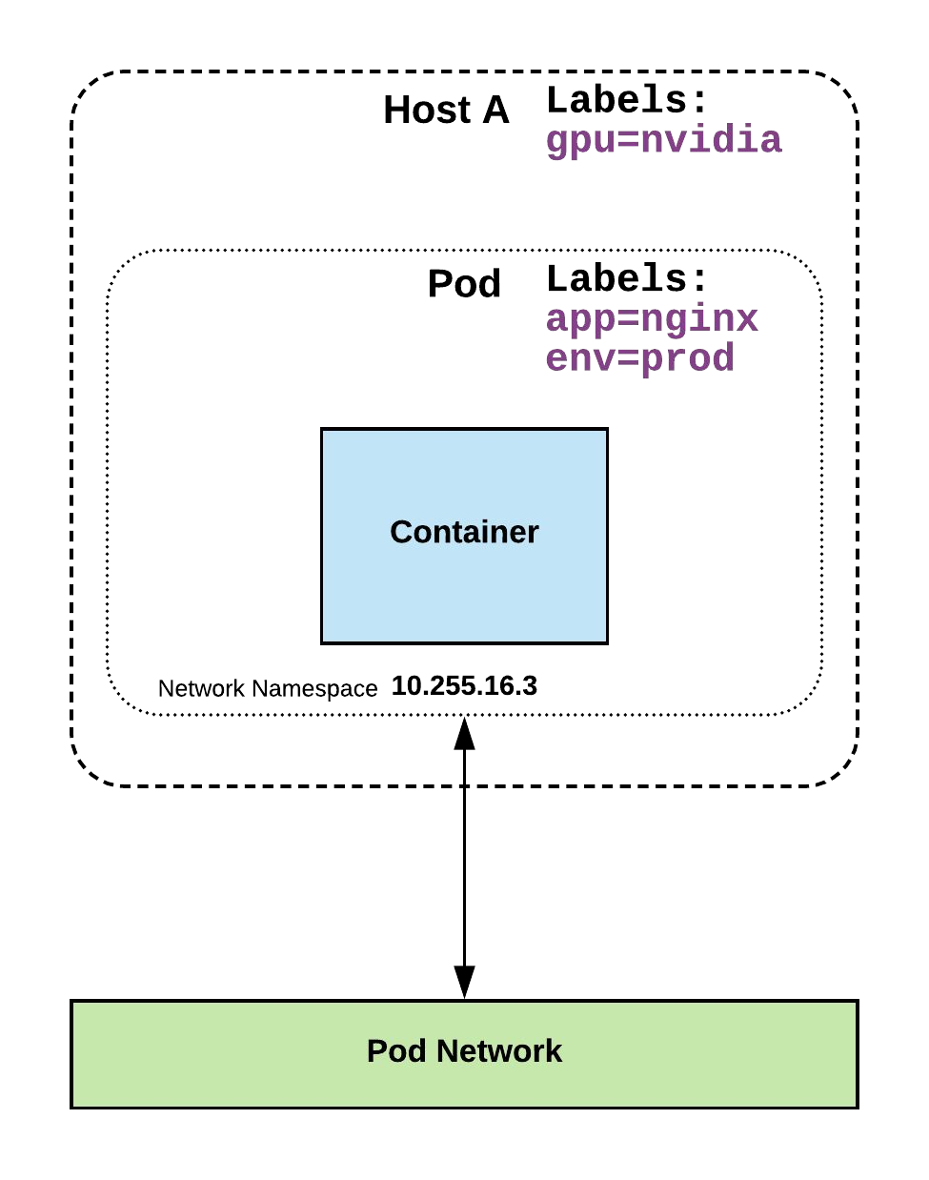
Labels
key-value pairs that are used to identify, describe and group together related sets of objects or resources.
NOT characteristic of uniqueness.
Have a strict syntax with a slightly limited character set*.
* https://kubernetes.io/docs/concepts/overview/working-with-objects/labels/#syntax-and-character-set

Slide 62
Label Example
apiVersion: v1 kind: Pod metadata:
name: pod-label-example labels:
app: nginx env: prod
spec:
containers:
- name: nginx
image: nginx:stable-alpine ports:
- containerPort: 80

Slide 63
Selectors
Selectors use labels to filter or select objects, and are used throughout Kubernetes.
apiVersion: v1 kind: Pod metadata:
name: pod-label-example labels:
app: nginx env: prod
spec:
containers:
- name: nginx
image: nginx:stable-alpine ports:
- containerPort: 80 nodeSelector:
gpu: nvidia

Slide 64
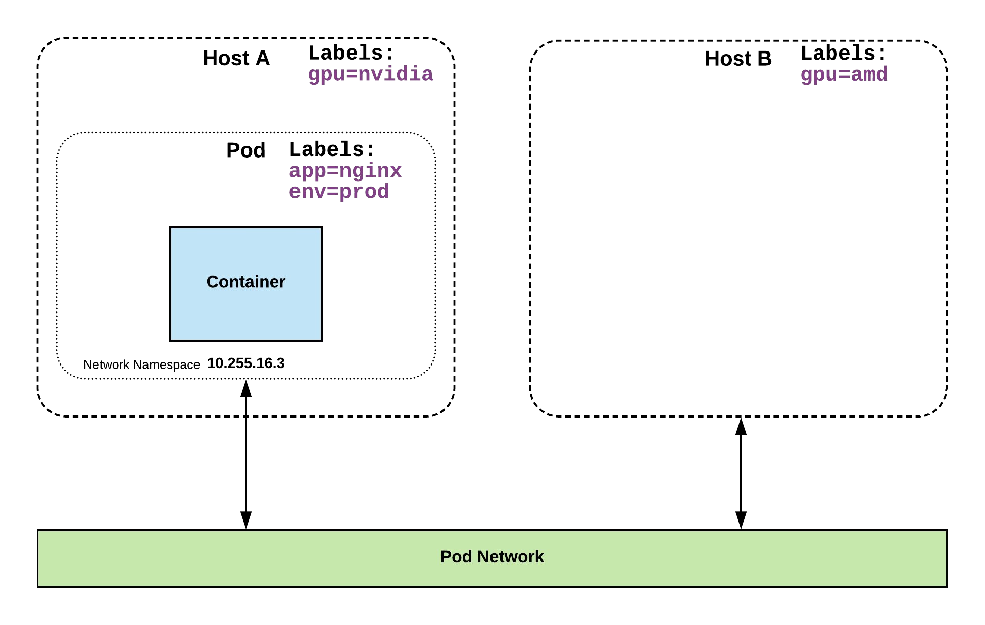
Selector Example
apiVersion: v1 kind: Pod metadata:
name: pod-label-example labels:
app: nginx env: prod
spec:
containers:
- name: nginx
image: nginx:stable-alpine ports:
- containerPort: 80 nodeSelector:
gpu: nvidia

Slide 65
Selector Types
Equality based selectors allow for simple filtering (=,==, or !=).
Set-based selectors are supported on a limited subset of objects.
However, they provide a method of filtering on a set of values, and supports multiple operators including: in, notin, and exist.
selector: matchLabels:
gpu: nvidia
selector: matchExpressions:
- key: gpu operator: in
values: [“nvidia”]

Slide 66
Services
Unified method of accessing the exposed workloads of Pods.
Durable resource (unlike Pods)
static cluster-unique IP
static namespaced DNS name
<service name>.<namespace>.svc.cluster.local

Slide 67
Services
Target Pods using equality based selectors.
Uses kube-proxy to provide simple load-balancing.
kube-proxy acts as a daemon that creates local entries in the host’s iptables for every service.

Slide 68
Service Types
There are 4 major service types:
ClusterIP (default)
NodePort
LoadBalancer
ExternalName

Slide 69
ClusterIP Service
apiVersion: v1 kind: Service metadata:
name: example-prod spec:
selector: app: nginx env: prod
ports:
- protocol: TCP port: 80
targetPort: 80
ClusterIP services exposes a service on a strictly cluster internal virtual IP.

Slide 70
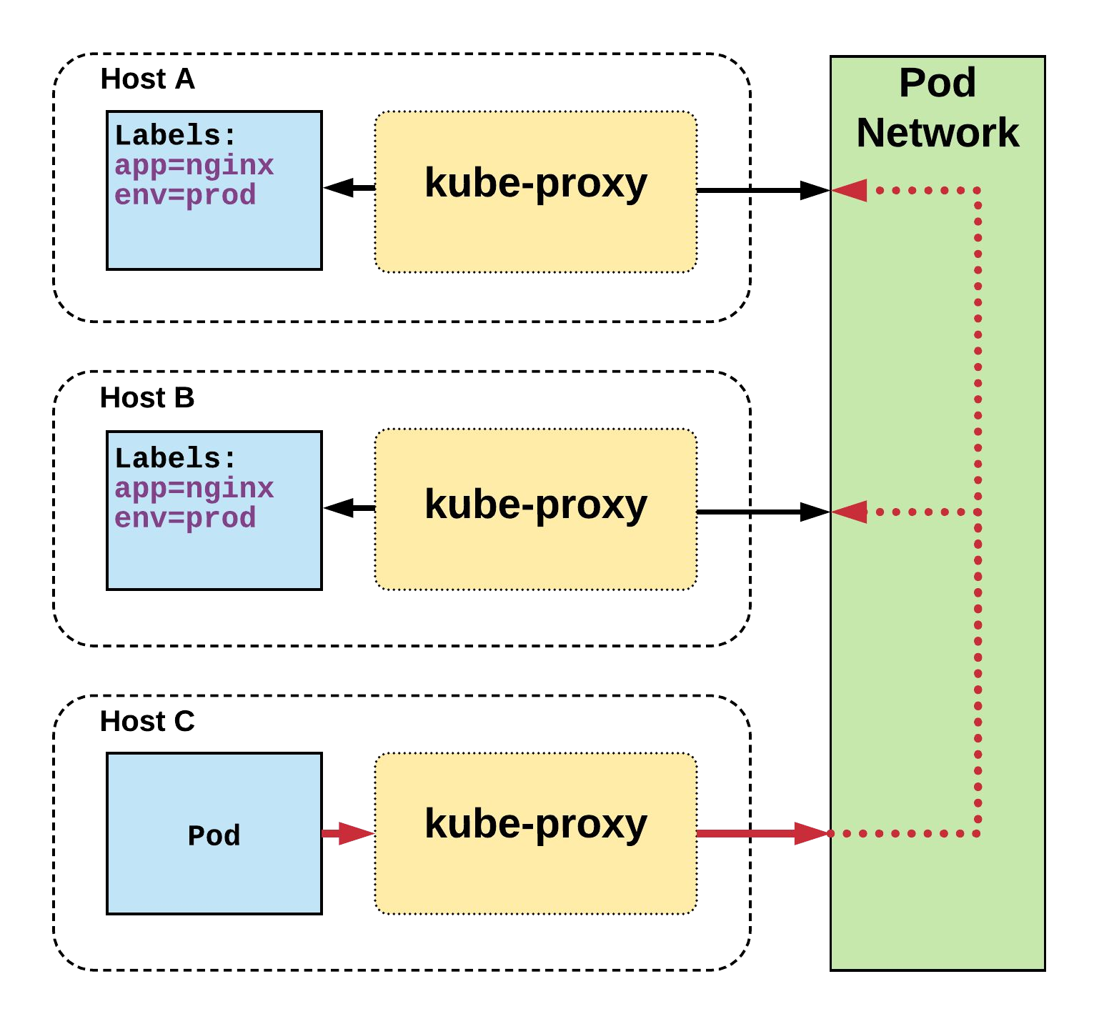
Cluster IP Service
Name: Selector: Type:
IP:
Port: TargetPort: Endpoints:
example-prod app=nginx,env=prod ClusterIP 10.96.28.176
<unset> 80/TCP 80/TCP
10.255.16.3:80,
10.255.16.4:80
/ # nslookup example-prod.default.svc.cluster.local
Name: example-prod.default.svc.cluster.local
Address 1: 10.96.28.176 example-prod.default.svc.cluster.local

Slide 71
NodePort Service
apiVersion: v1 kind: Service metadata:
name: example-prod spec:
type: NodePort selector:
app: nginx env: prod
ports:
- nodePort: 32410 protocol: TCP port: 80
targetPort: 80
NodePort services extend the
ClusterIP service.
Exposes a port on every node’s IP.
Port can either be statically defined, or dynamically taken from a range between
30000-32767.

Slide 72
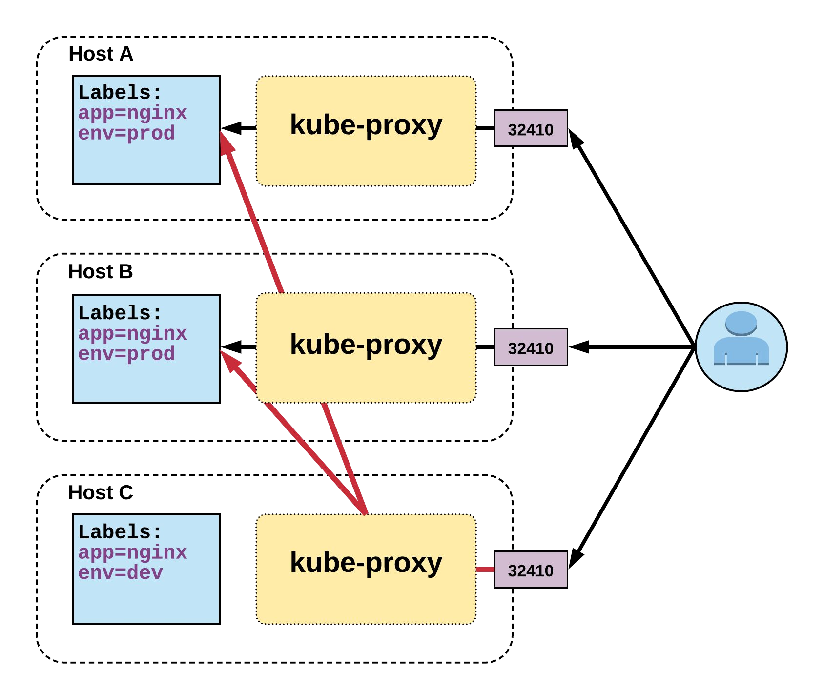
NodePort Service
Name: Selector: Type:
IP:
Port: TargetPort: NodePort: Endpoints:
example-prod app=nginx,env=prod NodePort 10.96.28.176
<unset> 80/TCP 80/TCP
<unset> 32410/TCP
10.255.16.3:80,
10.255.16.4:80

Slide 73
LoadBalancer Service
apiVersion: v1 kind: Service metadata:
name: example-prod spec:
type: LoadBalancer selector:
app: nginx env: prod
ports:
protocol: TCP port: 80
targetPort: 80
LoadBalancer services extend NodePort.
Works in conjunction with an external system to map a cluster external IP to the exposed service.

Slide 74
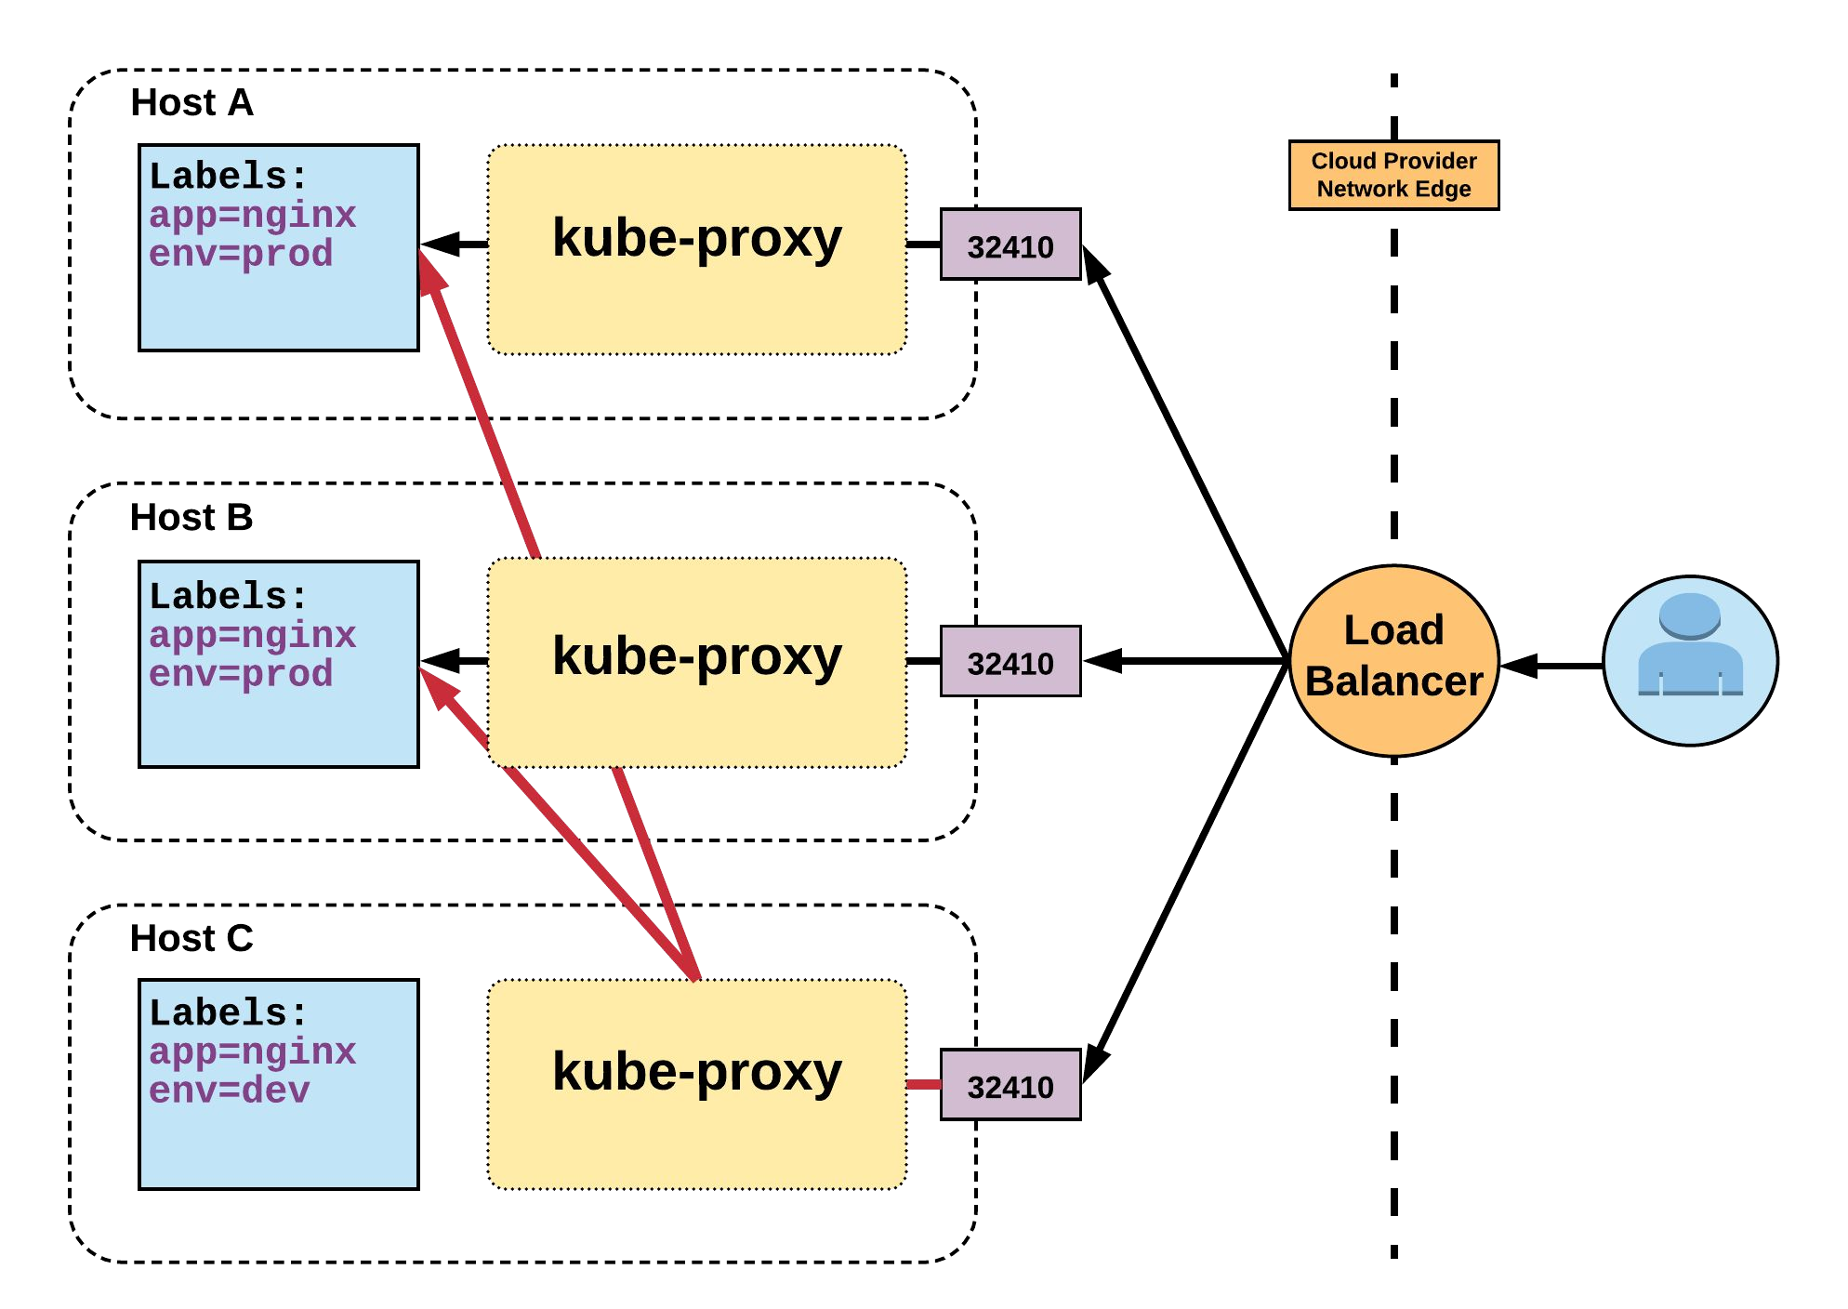
LoadBalancer Service
Name: Selector: Type:
IP:
LoadBalancer Ingress: Port: TargetPort: NodePort: Endpoints:
example-prod app=nginx,env=prod LoadBalancer 10.96.28.176
172.17.18.43
<unset> 80/TCP 80/TCP
<unset> 32410/TCP 10.255.16.3:80,
10.255.16.4:80

Slide 75
ExternalName Service
apiVersion: v1 kind: Service metadata:
name: example-prod spec:
type: ExternalName spec:
externalName: example.com
ExternalName is used to reference endpoints OUTSIDE the cluster.
Creates an internal CNAME DNS entry that aliases another.

Slide 76
ReplicaSet
Deployment
DaemonSet
StatefulSet
Job
CronJob
Workloads
Concepts and Resources

Slide 77
Workloads
Workloads within Kubernetes are higher level objects that manage Pods or other higher level objects.
In ALL CASES a Pod Template is included, and acts the base tier of management.

Slide 78
Pod Template
Workload Controllers manage instances of Pods based off a provided template.
Pod Templates are Pod specs with limited metadata.
Controllers use Pod Templates to make actual pods.
apiVersion: v1 kind: Pod metadata:
name: pod-example labels:
app: nginx spec:
containers:
- name: nginx image: nginx
template: metadata:
labels: app: nginx
spec:
containers:
- name: nginx image: nginx

Slide 79
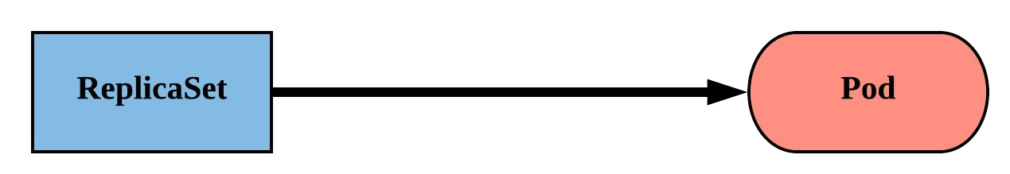
ReplicaSet
Primary method of managing pod replicas and their lifecycle.
Includes their scheduling, scaling, and deletion.
Their job is simple: Always ensure the desired number of pods are running.

Slide 80
ReplicaSet
replicas: The desired number of instances of the Pod.
selector:The label selector for the ReplicaSet will manage ALL Pod instances that it targets; whether it’s desired or not.
apiVersion: apps/v1 kind: ReplicaSet metadata:
name: rs-example spec:
replicas: 3 selector:
matchLabels: app: nginx env: prod
template:
<pod template>

Slide 81
ReplicaSet
apiVersion: apps/v1 kind: ReplicaSet metadata:
name: rs-example spec:
replicas: 3 selector:
matchLabels: app: nginx env: prod
template: metadata:
labels: app: nginx env: prod
spec:
containers:
- name: nginx
image: nginx:stable-alpine ports:
- containerPort: 80
$ kubectl get pods
NAME READY
rs-example-9l4dt 1/1 rs-example-b7bcg 1/1 rs-example-mkll2 1/1
STATUS RESTARTS AGE
Running 0 1h
Running 0 1h
Running 0 1h
$ kubectl describe rs rs-example Name: rs-example Namespace: default
Selector: app=nginx,env=prod Labels: app=nginx
env=prod Annotations: <none>
Replicas: 3 current / 3 desired
Pods Status: 3 Running / 0 Waiting / 0 Succeeded / 0 Failed Pod Template:
Labels: app=nginx
env=prod Containers: nginx:
Image: Port:
Environment: Mounts:
Volumes: Events:
Type Reason
nginx:stable-alpine
80/TCP
<none>
<none>
<none>
Age From Message
Normal SuccessfulCreate 16s replicaset-controller Created pod: rs-example-mkll2 Normal SuccessfulCreate 16s replicaset-controller Created pod: rs-example-b7bcg Normal SuccessfulCreate 16s replicaset-controller Created pod: rs-example-9l4dt

Slide 82
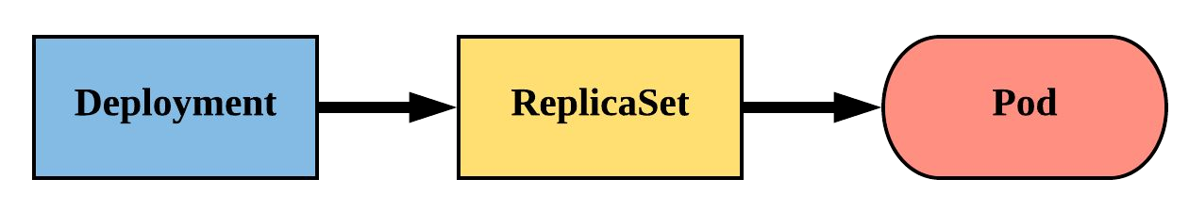
Deployment
Declarative method of managing Pods via ReplicaSets.
Provide rollback functionality and update control.
Updates are managed through the pod-template-hash
label.
Each iteration creates a unique label that is assigned to both the ReplicaSet and subsequent Pods.

Slide 83
Deployment
revisionHistoryLimit: The number of previous iterations of the Deployment to retain.
strategy: Describes the method of updating the Pods based on the type. Valid options are RollingUpdate or Recreate.
RollingUpdate: Cycles through updating the Pods according to the parameters: maxSurge and maxUnavailable.
Recreate: All existing Pods are killed before the new ones are created.
apiVersion: apps/v1 kind: Deployment metadata:
name: deploy-example spec:
replicas: 3
revisionHistoryLimit: 3 selector:
matchLabels: app: nginx env: prod
strategy:
type: RollingUpdate rollingUpdate:
maxSurge: 1
maxUnavailable: 0 template:
<pod template>

Slide 84
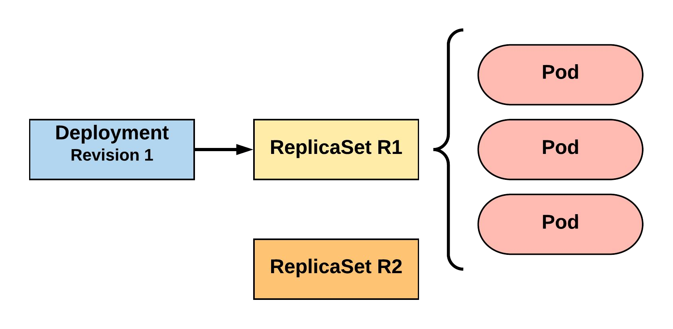
RollingUpdate Deployment
Updating pod template generates a new ReplicaSet revision.
R1 pod-template-hash: 676677fff R2 pod-template-hash: 54f7ff7d6d
$ kubectl get replicaset NAME DESIRED | CURRENT | READY | AGE
mydep-6766777fff 3 | 3 | 3 | 5h
$ kubectl get pods NAME READY | STATUS | RESTARTS | AGE
mydep-6766777fff-9r2zn 1/1 | Running | 0 | 5h
mydep-6766777fff-hsfz9 1/1 | Running | 0 | 5h
mydep-6766777fff-sjxhf 1/1 | Running | 0 | 5h

Slide 85
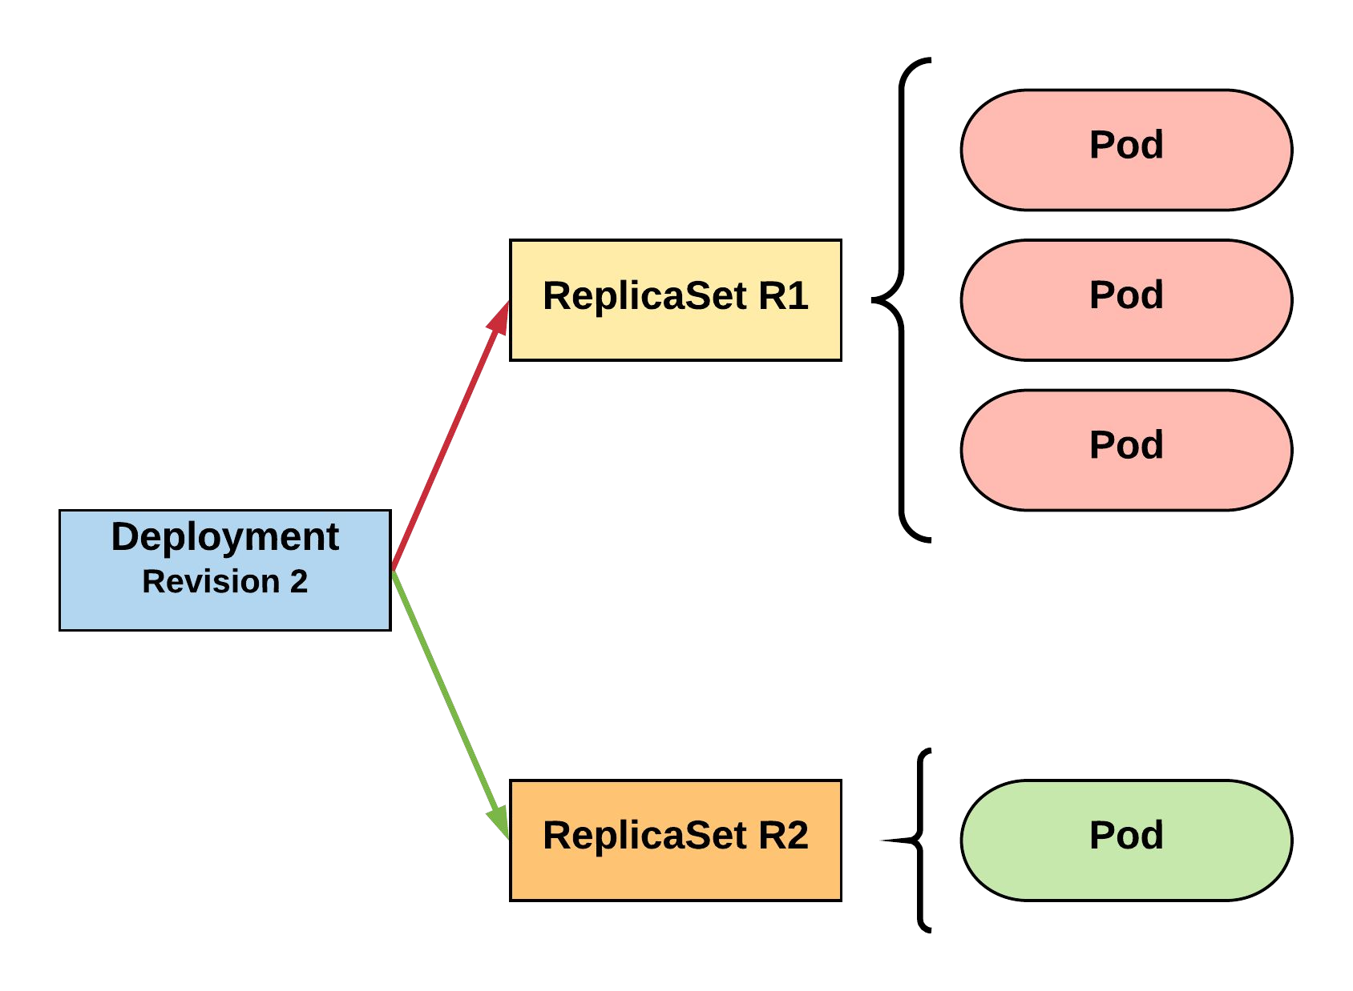
RollingUpdate Deployment
New ReplicaSet is initially scaled up based on maxSurge.
R1 pod-template-hash: 676677fff R2 pod-template-hash: 54f7ff7d6d
$ kubectl get replicaset NAME DESIRED | CURRENT | READY | AGE
mydep-54f7ff7d6d 1 | 1 | 1 | 5s
mydep-6766777fff 2 | 3 | 3 | 5h
$ kubectl get pods NAME READY | STATUS | RESTARTS | AGE
mydep-54f7ff7d6d-9gvll 1/1 | Running | 0 | 2s
mydep-6766777fff-9r2zn 1/1 | Running | 0 | 5h
mydep-6766777fff-hsfz9 1/1 | Running | 0 | 5h
mydep-6766777fff-sjxhf 1/1 | Running | 0 | 5h

Slide 86
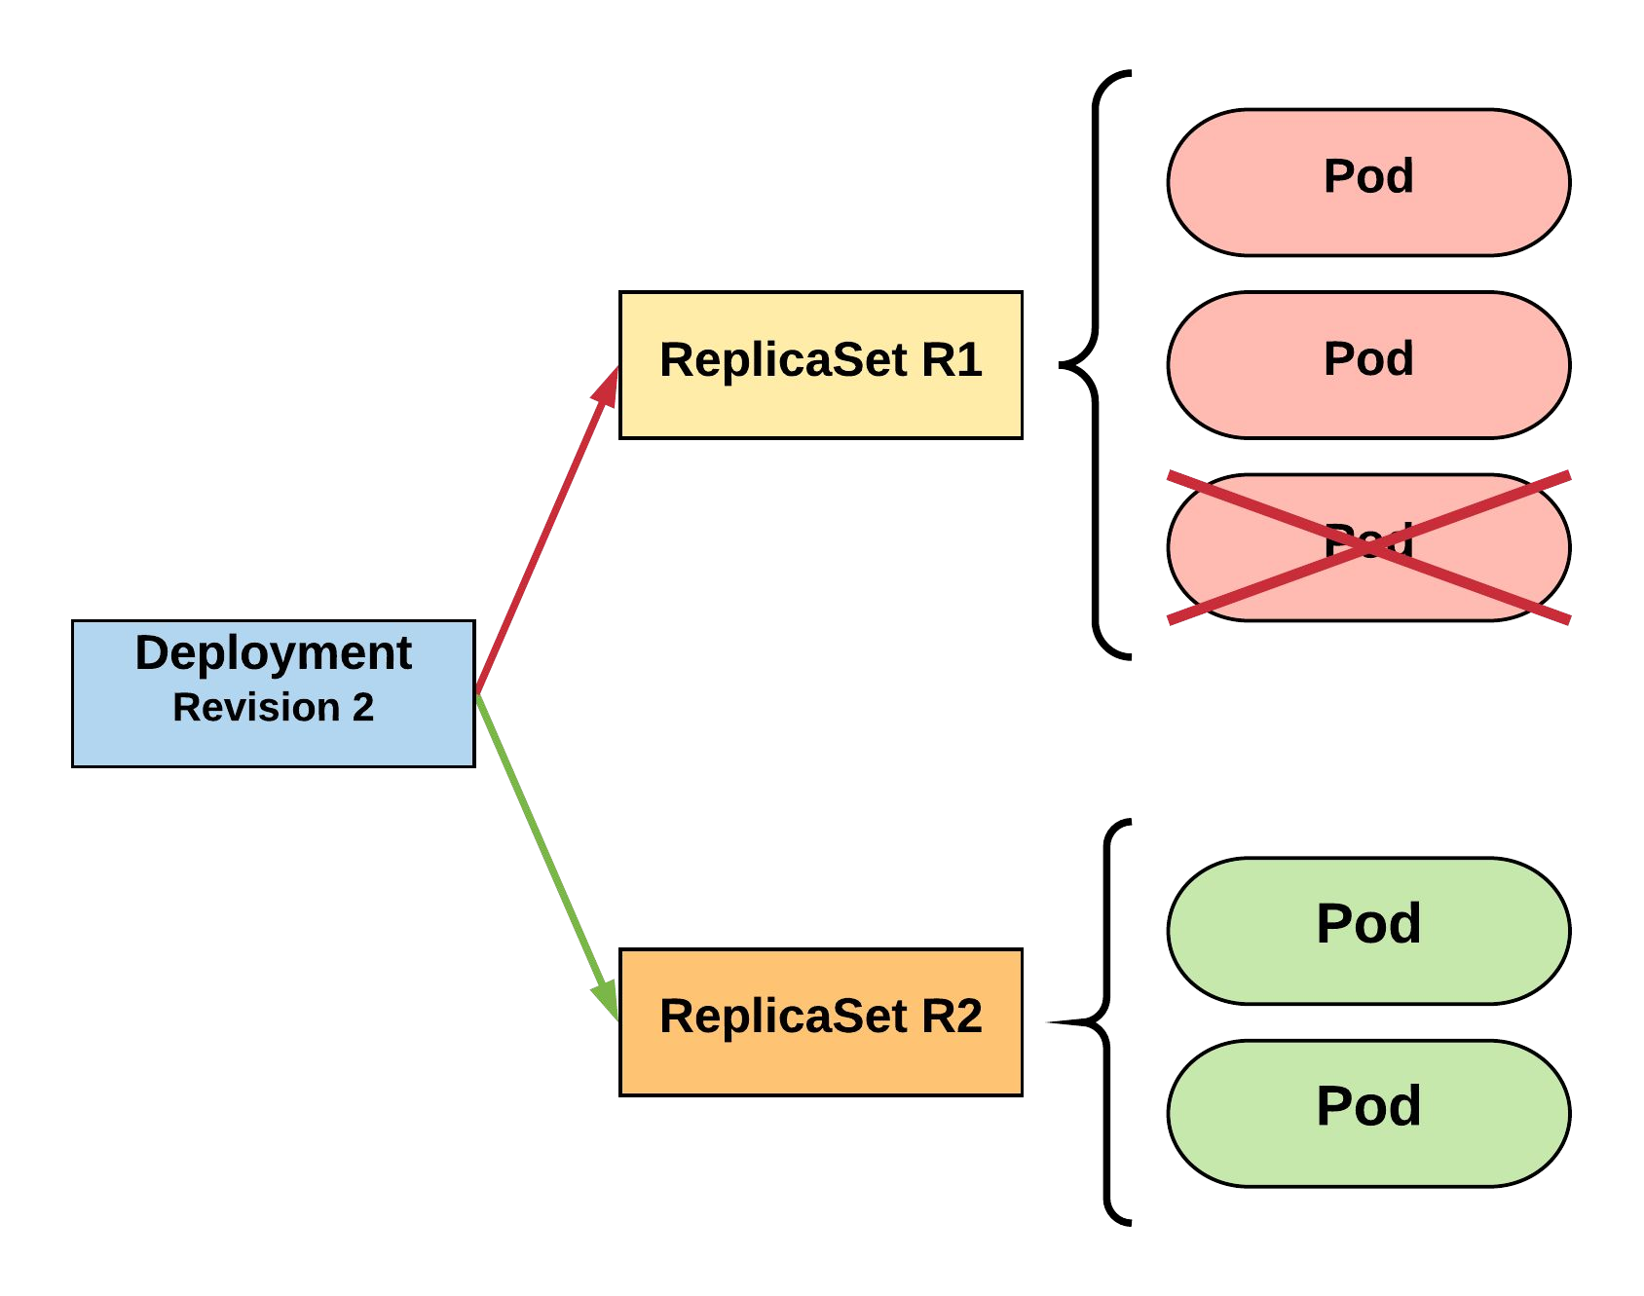
RollingUpdate Deployment
Phase out of old Pods managed by
maxSurge and maxUnavailable.
R1 pod-template-hash: 676677fff R2 pod-template-hash: 54f7ff7d6d
$ kubectl get replicaset NAME DESIRED | CURRENT | READY | AGE
mydep-54f7ff7d6d 2 | 2 | 2 | 8s
mydep-6766777fff 2 | 2 | 2 | 5h
$ kubectl get pods NAME READY | STATUS | RESTARTS | AGE
mydep-54f7ff7d6d-9gvll 1/1 | Running | 0 | 5s
mydep-54f7ff7d6d-cqvlq 1/1 | Running | 0 | 2s
mydep-6766777fff-9r2zn 1/1 | Running | 0 | 5h
mydep-6766777fff-hsfz9 1/1 | Running | 0 | 5h

Slide 87
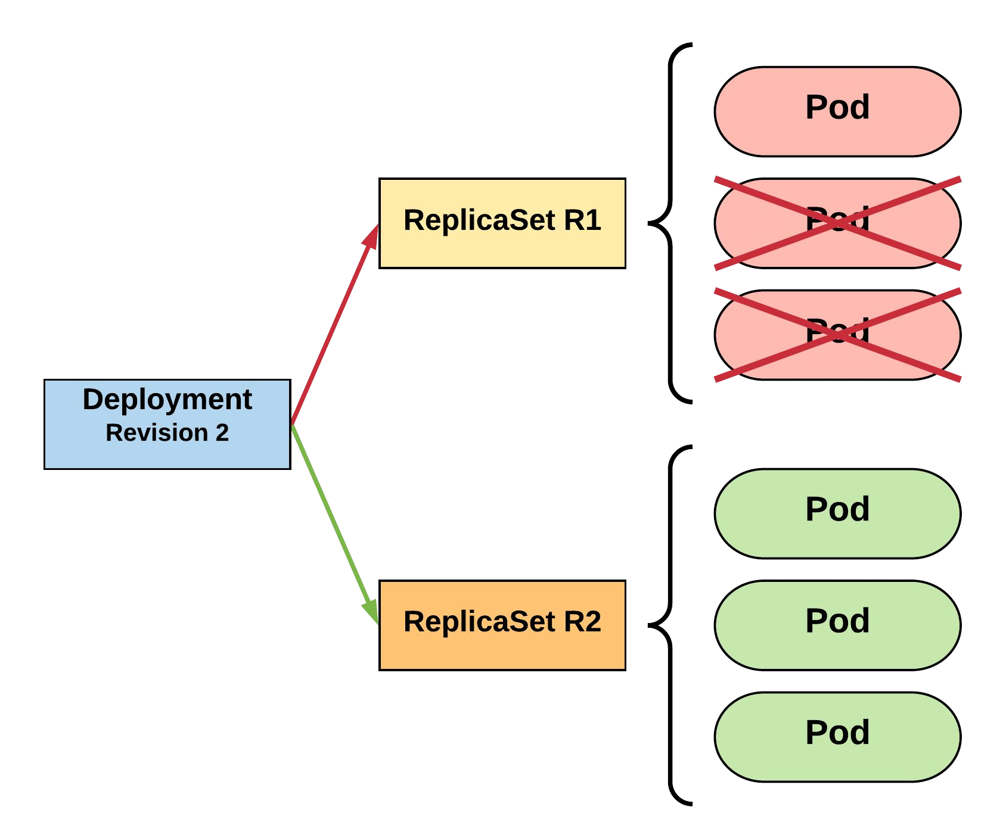
RollingUpdate Deployment
Phase out of old Pods managed by
maxSurge and maxUnavailable.
R1 pod-template-hash: 676677fff R2 pod-template-hash: 54f7ff7d6d
$ kubectl get replicaset NAME DESIRED | CURRENT | READY | AGE
mydep-54f7ff7d6d 3 | 3 | 3 | 10s
mydep-6766777fff 0 | 1 | 1 | 5h
$ kubectl get pods NAME READY | STATUS | RESTARTS | AGE
mydep-54f7ff7d6d-9gvll 1/1 | Running | 0 | 7s
mydep-54f7ff7d6d-cqvlq 1/1 | Running | 0 | 5s
mydep-54f7ff7d6d-gccr6 1/1 | Running | 0 | 2s
mydep-6766777fff-9r2zn 1/1 | Running | 0 | 5h

Slide 88
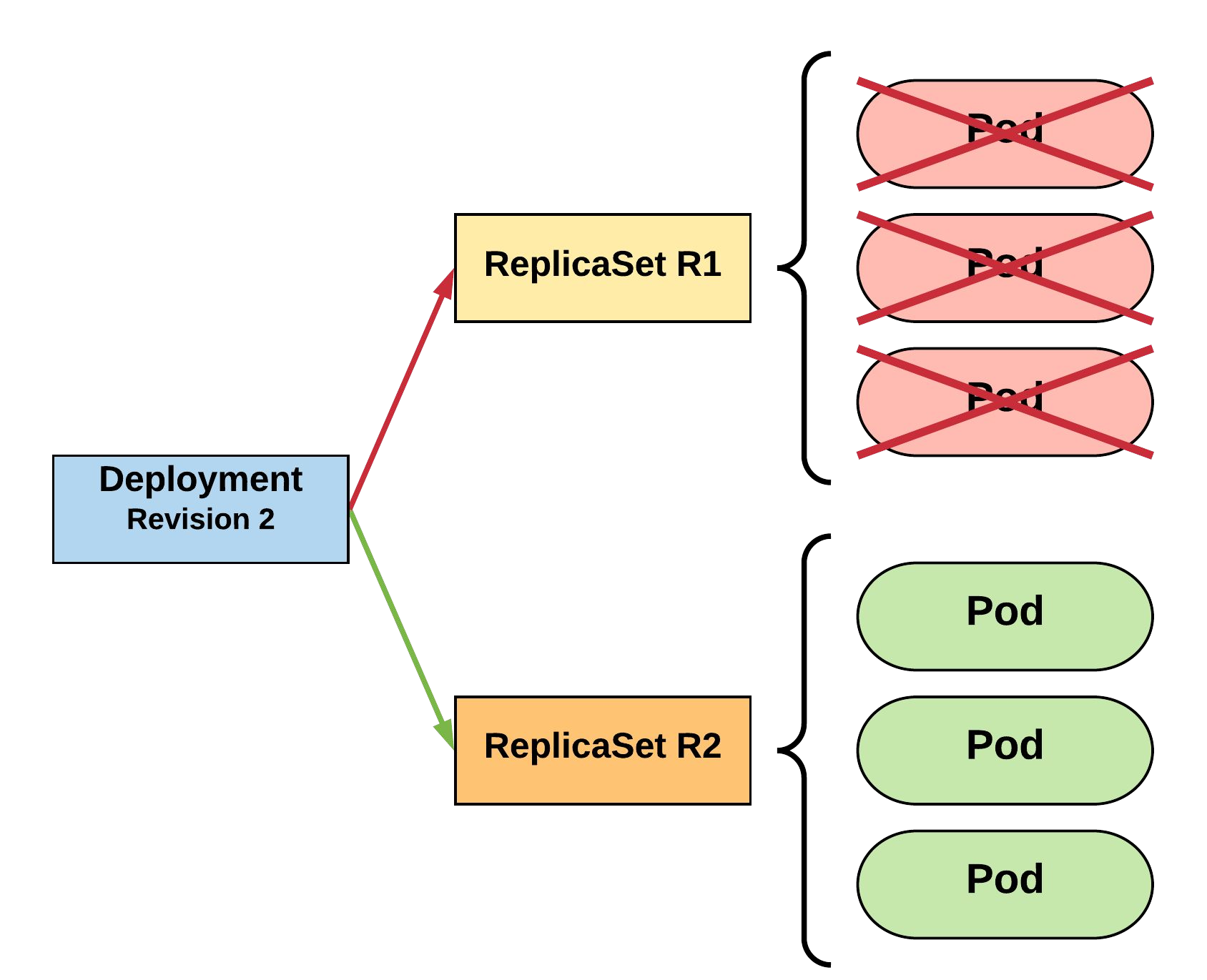
RollingUpdate Deployment
Phase out of old Pods managed by
maxSurge and maxUnavailable.
R1 pod-template-hash: 676677fff R2 pod-template-hash: 54f7ff7d6d
$ kubectl get replicaset NAME DESIRED | CURRENT | READY | AGE
mydep-54f7ff7d6d 3 | 3 | 3 | 13s
mydep-6766777fff 0 | 0 | 0 | 5h
$ kubectl get pods NAME READY | STATUS | RESTARTS | AGE
mydep-54f7ff7d6d-9gvll 1/1 | Running | 0 | 10s
mydep-54f7ff7d6d-cqvlq 1/1 | Running | 0 | 8s
mydep-54f7ff7d6d-gccr6 1/1 | Running | 0 | 5s

Slide 89
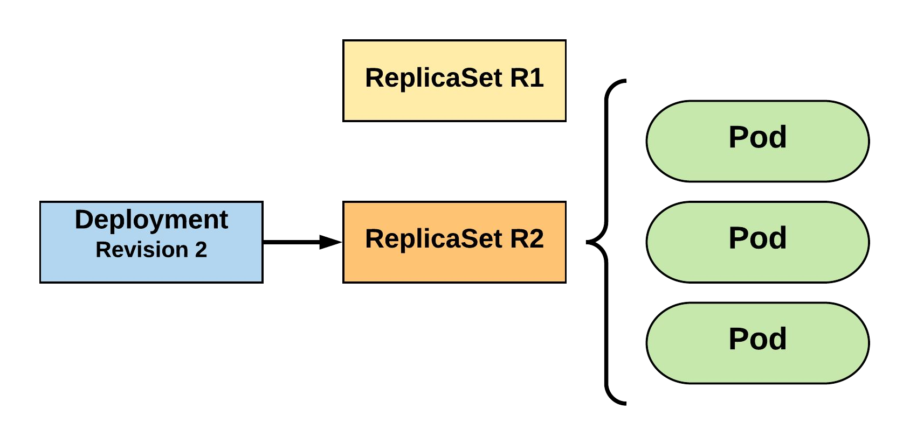
RollingUpdate Deployment
Updated to new deployment revision completed.
R1 pod-template-hash: 676677fff R2 pod-template-hash: 54f7ff7d6d
$ kubectl get replicaset NAME DESIRED | CURRENT | READY | AGE
mydep-54f7ff7d6d 3 | 3 | 3 | 15s
mydep-6766777fff 0 | 0 | 0 | 5h
$ kubectl get pods NAME READY | STATUS | RESTARTS | AGE
mydep-54f7ff7d6d-9gvll 1/1 | Running | 0 | 12s
mydep-54f7ff7d6d-cqvlq 1/1 | Running | 0 | 10s
mydep-54f7ff7d6d-gccr6 1/1 | Running | 0 | 7s

Slide 90
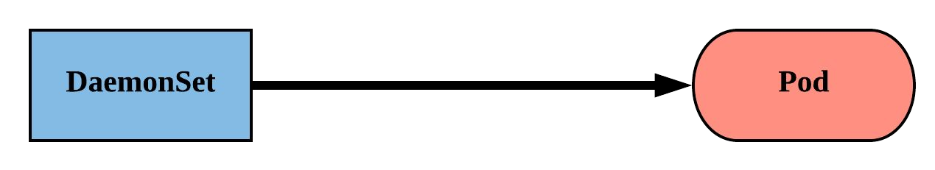
DaemonSet
Ensure that all nodes matching certain criteria will run an instance of the supplied Pod.
They bypass default scheduling mechanisms.
Are ideal for cluster wide services such as log forwarding, or health monitoring.
Revisions are managed via a controller-revision-hash
label.

Slide 91
DaemonSet
revisionHistoryLimit: The number of previous iterations of the DaemonSet to retain.
updateStrategy: Describes the method of updating the Pods based on the type. Valid options are RollingUpdate or OnDelete.
RollingUpdate: Cycles through updating the Pods according to the value of maxUnavailable.
OnDelete: The new instance of the Pod is deployed ONLY after the current instance is deleted.
apiVersion: apps/v1 kind: DaemonSet metadata:
name: ds-example spec:
revisionHistoryLimit: 3 selector:
matchLabels: app: nginx
updateStrategy: type: RollingUpdate rollingUpdate:
maxUnavailable: 1 template:
spec:
nodeSelector: nodeType: edge
<pod template>

Slide 92
DaemonSet
spec.template.spec.nodeSelector:
The primary selector used to target nodes.
Default Host Labels:
apiVersion: apps/v1 kind: DaemonSet metadata:
name: ds-example spec:
revisionHistoryLimit: 3 selector:
matchLabels: app: nginx
updateStrategy: type: RollingUpdate rollingUpdate:
maxUnavailable: 1 template:
spec:
nodeSelector: nodeType: edge
<pod template>
kubernetes.io/hostname
beta.kubernetes.io/os
beta.kubernetes.io/arch
Cloud Host Labels:
failure-domain.beta.kubernetes.io/zone
failure-domain.beta.kubernetes.io/region
beta.kubernetes.io/instance-type

Slide 93
DaemonSet
apiVersion: apps/v1 kind: DaemonSet metadata:
name: ds-example spec:
revisionHistoryLimit: 3 selector:
matchLabels: app: nginx
updateStrategy:
type: RollingUpdate rollingUpdate:
maxUnavailable: 1 template:
metadata: labels:
app: nginx spec:
nodeSelector: nodeType: edge
containers:
- name: nginx
image: nginx:stable-alpine ports:
- containerPort: 80
$ kubectl get pods
NAME READY
ds-example-x8kkz 1/1
STATUS RESTARTS AGE
Running 0 1m
$ kubectl describe ds ds-example Name: ds-example
Selector: app=nginx,env=prod Node-Selector: nodeType=edge Labels: app=nginx
env=prod Annotations: <none>
Desired Number of Nodes Scheduled: 1 Current Number of Nodes Scheduled: 1
Number of Nodes Scheduled with Up-to-date Pods: 1 Number of Nodes Scheduled with Available Pods: 1 Number of Nodes Misscheduled: 0
Pods Status: 1 Running / 0 Waiting / 0 Succeeded / 0 Failed Pod Template:
Labels: app=nginx
env=prod Containers: nginx:
Image: Port:
Environment: Mounts:
Volumes: Events:
Type Reason
nginx:stable-alpine 80/TCP
<none>
<none>
<none>
Age From Message
Normal SuccessfulCreate 48s daemonset-controller Created pod: ds-example-x8kkz

Slide 94
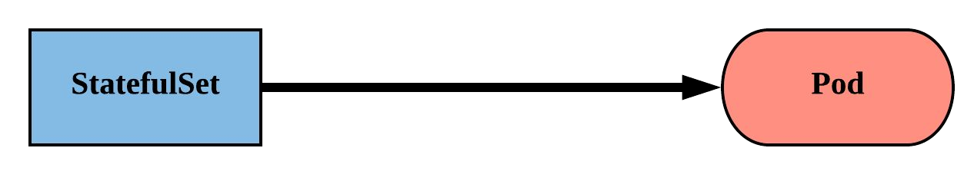
StatefulSet
Tailored to managing Pods that must persist or maintain state.
Pod identity including hostname, network, and
storage WILL be persisted.
Pod lifecycle will be ordered and follow consistent patterns.

Slide 95
StatefulSet
Assigned a unique ordinal name following the convention of ‘<statefulset name>-<ordinal index>’.
Ordinal pattern is also passed to the Pod’s network Identity and volumes.
Revisions are managed via a controller-revision-hash
label

Slide 96
StatefulSet
apiVersion: apps/v1 kind: StatefulSet metadata:
name: sts-example spec:
replicas: 2
revisionHistoryLimit: 3 selector:
matchLabels: app: stateful
serviceName: app updateStrategy:
type: RollingUpdate rollingUpdate:
partition: 0 template:
metadata: labels:
app: stateful
<continued>
<continued>
spec:
containers:
name: nginx
image: nginx:stable-alpine ports:
containerPort: 80 volumeMounts:
name: www
mountPath: /usr/share/nginx/html volumeClaimTemplates:
- metadata:
name: www spec:
accessModes: [ "ReadWriteOnce" ] storageClassName: standard resources:
requests: storage: 1Gi

Slide 97
StatefulSet
apiVersion: apps/v1 kind: StatefulSet metadata:
name: sts-example spec:
replicas: 2
revisionHistoryLimit: 3 selector:
matchLabels: app: stateful
serviceName: app updateStrategy: type: RollingUpdate rollingUpdate:
partition: 0 template:
<pod template>
revisionHistoryLimit: The number of previous iterations of the StatefulSet to retain.
serviceName: The name of the associated headless service; or a service without a ClusterIP.

Slide 98
StatefulSet
apiVersion: apps/v1 kind: StatefulSet metadata:
name: sts-example spec:
replicas: 2
revisionHistoryLimit: 3 selector:
matchLabels: app: stateful
serviceName: app updateStrategy: type: RollingUpdate rollingUpdate:
partition: 0 template:
<pod template>
updateStrategy: Describes the method of updating the Pods based on the type. Valid options are OnDelete or RollingUpdate.
OnDelete: The new instance of the Pod is deployed ONLY after the current instance is deleted.
RollingUpdate: Pods with an ordinal greater than the partition value will be updated in one-by-one in reverse order.

Slide 99
StatefulSet
volumeClaimTemplates: Template of the persistent volume(s) request to use for each instance of the StatefulSet.
spec:
containers:
name: nginx
image: nginx:stable-alpine ports:
containerPort: 80 volumeMounts:
name: www
mountPath: /usr/share/nginx/html volumeClaimTemplates:
- metadata:
name: www spec:
accessModes: [ "ReadWriteOnce" ] storageClassName: standard resources:
requests: storage: 1Gi

Slide 100
Headless Service
<StatefulSet Name>-<ordinal>.<service name>.<namespace>.svc.cluster.local
apiVersion: v1 kind: Service metadata:
name: app spec:
clusterIP: None selector:
app: stateful ports:
- protocol: TCP port: 80
targetPort: 80
/ # dig app.default.svc.cluster.local +noall +answer
; <<>> DiG 9.11.2-P1 <<>> app.default.svc.cluster.local +noall +answer
;; global options: +cmd app.default.svc.cluster.local. 2 IN A 10.255.0.5
app.default.svc.cluster.local. 2 IN A 10.255.0.2
/ # dig sts-example-0.app.default.svc.cluster.local +noall +answer
; <<>> DiG 9.11.2-P1 <<>> sts-example-0.app.default.svc.cluster.local +noall +answer
;; global options: +cmd
sts-example-0.app.default.svc.cluster.local. 20 IN A 10.255.0.2
/ # dig sts-example-1.app.default.svc.cluster.local +noall +answer
; <<>> DiG 9.11.2-P1 <<>> sts-example-1.app.default.svc.cluster.local +noall +answer
;; global options: +cmd
sts-example-1.app.default.svc.cluster.local. 30 IN A 10.255.0.5
$ kubectl get pods
NAME | READY | STATUS | RESTARTS | AGE
sts-example-0 | 1/1 | Running | 0 | 11m
sts-example-1 | 1/1 | Running | 0 | 11m

Slide 101
Headless Service
<StatefulSet Name>-<ordinal>.<service name>.<namespace>.svc.cluster.local
apiVersion: v1 kind: Service metadata:
name: app spec:
clusterIP: None selector:
app: stateful ports:
- protocol: TCP port: 80
targetPort: 80
/ # dig app.default.svc.cluster.local +noall +answer
; <<>> DiG 9.11.2-P1 <<>> app.default.svc.cluster.local +noall +answer
;; global options: +cmd
app.default.svc.cluster.local. 2 IN A 10.255.0.5
app.default.svc.cluster.local. 2 IN A 10.255.0.2
/ # dig sts-example-0.app.default.svc.cluster.local +noall +answer
; <<>> DiG 9.11.2-P1 <<>> sts-example-0.app.default.svc.cluster.local +noall +answer
;; global options: +cmd
sts-example-0.app.default.svc.cluster.local. 20 IN A 10.255.0.2
/ # dig sts-example-1.app.default.svc.cluster.local +noall +answer
; <<>> DiG 9.11.2-P1 <<>> sts-example-1.app.default.svc.cluster.local +noall +answer
;; global options: +cmd
sts-example-1.app.default.svc.cluster.local. 30 IN A 10.255.0.5
$ kubectl get pods
NAME | READY | STATUS | RESTARTS | AGE
sts-example-0 | 1/1 | Running | 0 | 11m
sts-example-1 | 1/1 | Running | 0 | 11m

Slide 102
Headless Service
<StatefulSet Name>-<ordinal>.<service name>.<namespace>.svc.cluster.local
apiVersion: v1 kind: Service metadata:
name: app spec:
clusterIP: None selector:
app: stateful ports:
- protocol: TCP port: 80
targetPort: 80
/ # dig app.default.svc.cluster.local +noall +answer
; <<>> DiG 9.11.2-P1 <<>> app.default.svc.cluster.local +noall +answer
;; global options: +cmd app.default.svc.cluster.local. 2 IN A 10.255.0.5
app.default.svc.cluster.local. 2 IN A 10.255.0.2
/ # dig sts-example-0.app.default.svc.cluster.local +noall +answer
; <<>> DiG 9.11.2-P1 <<>> sts-example-0.app.default.svc.cluster.local +noall +answer
;; global options: +cmd
sts-example-0.app.default.svc.cluster.local. 20 IN A 10.255.0.2
/ # dig sts-example-1.app.default.svc.cluster.local +noall +answer
; <<>> DiG 9.11.2-P1 <<>> sts-example-1.app.default.svc.cluster.local +noall +answer
$ kubectl get pods
NAME | READY | STATUS | RESTARTS | AGE
sts-example-0 | 1/1 | Running | 0 | 11m
sts-example-1 | 1/1 | Running | 0 | 11m
;; global options: +cmd
sts-example-1.app.default.svc.cluster.local. 30 IN A 10.255.0.5

Slide 103
VolumeClaimTemplate
<Volume Name>-<StatefulSet Name>-<ordinal>
volumeClaimTemplates:
- metadata:
name: www spec:
accessModes: [ "ReadWriteOnce" ] storageClassName: standard resources:
requests: storage: 1Gi
Persistent Volumes associated with a StatefulSet will NOT be automatically garbage collected when it’s associated StatefulSet is deleted. They must manually be removed.
$ kubectl get pvc
NAME | STATUS | VOLUME | CAPACITY | ACCESS MODES | STORAGECLASS | AGE
www-sts-example-0 | Bound | pvc-d2f11e3b-18d0-11e8-ba4f-080027a3682b | 1Gi | RWO | standard | 4h
www-sts-example-1 | Bound | pvc-d3c923c0-18d0-11e8-ba4f-080027a3682b | 1Gi | RWO | standard | 4h

Slide 104
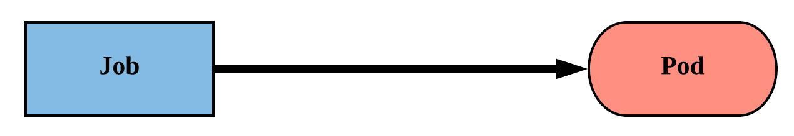
Job
Job controller ensures one or more pods are executed and successfully terminate.
Will continue to try and execute the job until it satisfies the completion and/or parallelism condition.
Pods are NOT cleaned up until the job itself is deleted.

Slide 105
Job
backoffLimit: The number of failures before the job itself is considered failed.
completions: The total number of successful completions desired.
parallelism: How many instances of the pod can be run concurrently.
spec.template.spec.restartPolicy: Jobs only support a restartPolicy of type Never or OnFailure.
apiVersion: batch/v1 kind: Job
metadata:
name: job-example spec:
backoffLimit: 4
completions: 4
parallelism: 2 template:
spec:
restartPolicy: Never
<pod-template>

Slide 106
Job
apiVersion: batch/v1 kind: Job
metadata:
name: job-example spec:
backoffLimit: 4
completions: 4
parallelism: 2 template:
spec:
containers:
- name: hello
image: alpine:latest command: ["/bin/sh", "-c"]
args: ["echo hello from $HOSTNAME!"] restartPolicy: Never
$ kubectl describe job job-example
Name: Namespace: Selector: Labels:
Annotations: Parallelism: Completions: Start Time: Pods Statuses:
job-example default
controller-uid=19d122f4-1576-11e8-a4e2-080027a3682b controller-uid=19d122f4-1576-11e8-a4e2-080027a3682b job-name=job-example
<none> 2
4
Mon, 19 Feb 2018 08:09:21 -0500
0 Running / 4 Succeeded / 0 Failed
Pod Template:
Labels: controller-uid=19d122f4-1576-11e8-a4e2-080027a3682b job-name=job-example
Containers:
hello:
Image: alpine:latest Port: <none> Command:
/bin/sh
-c Args:
echo hello from $HOSTNAME! Environment: <none>
Mounts: Volumes:
Events:
<none>
<none>
$ kubectl get pods --show-all NAME READY STATUS RESTARTS AGE
job-example-dvxd2 | 0/1 | Completed | 0 | 51m
job-example-hknns | 0/1 | Completed | 0 | 52m
job-example-tphkm | 0/1 | Completed | 0 | 51m
job-example-v5fvq | 0/1 | Completed | 0 | 52m
Type Reason | Age | From | Message
---- ------ | ---- | ---- | -------
Normal SuccessfulCreate 52m Normal SuccessfulCreate 52m Normal SuccessfulCreate 51m Normal SuccessfulCreate 51m
job-controller Created pod: job-example-v5fvq job-controller Created pod: job-example-hknns job-controller Created pod: job-example-tphkm job-controller Created pod: job-example-dvxd2

Slide 107
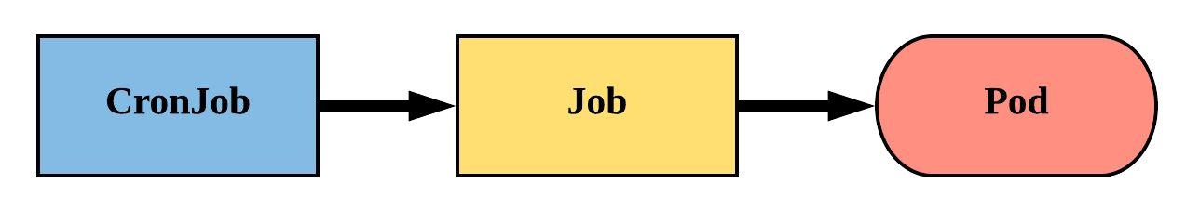
CronJob
An extension of the Job Controller, it provides a method of executing jobs on a cron-like schedule.
CronJobs within Kubernetes use UTC ONLY.

Slide 108
CronJob
schedule: The cron schedule for the job.
successfulJobHistoryLimit: The number of successful jobs to retain.
failedJobHistoryLimit: The number of failed jobs to retain.
apiVersion: batch/v1beta1 kind: CronJob
metadata:
name: cronjob-example spec:
schedule: "*/1 * * * *" successfulJobsHistoryLimit: 3
failedJobsHistoryLimit: 1 jobTemplate:
spec:
completions: 4
parallelism: 2 template:
<pod template>

Slide 109
CronJob
apiVersion: batch/v1beta1 kind: CronJob
metadata:
name: cronjob-example spec:
schedule: "*/1 * * * *" successfulJobsHistoryLimit: 3
failedJobsHistoryLimit: 1 jobTemplate:
spec:
completions: 4
parallelism: 2 template:
spec:
containers:
- name: hello
image: alpine:latest command: ["/bin/sh", "-c"]
args: ["echo hello from $HOSTNAME!"] restartPolicy: Never
$ kubectl describe cronjob cronjob-example
Name:
Namespace:
Labels: Annotations: Schedule: Concurrency Policy: Suspend:
Starting Deadline Seconds: Selector:
Parallelism: Completions:
Pod Template: Labels: <none> Containers: hello:
Image: alpine:latest Port: <none> Command:
/bin/sh
-c
cronjob-example
default
<none>
<none>
*/1 * * * * Allow
False
<unset>
<unset> 2
4
Args:
echo hello from $HOSTNAME! Environment: <none>
Mounts: <none>
Volumes: <none>
Last Schedule Time: Mon, 19 Feb 2018 09:54:00 -0500 Active Jobs: cronjob-example-1519052040 Events:
Type Reason
$ kubectl get jobs
NAME DESIRED SUCCESSFUL AGE
cronjob-example-1519053240 4 4 2m
cronjob-example-1519053300 4 4 1m
cronjob-example-1519053360 4 4 26s
---- ------
Normal SuccessfulCreate Normal SawCompletedJob Normal SuccessfulCreate Normal SawCompletedJob Normal SuccessfulCreate
Age From Message
---- ---- -------
3m cronjob-controller Created job cronjob-example-1519051860
2m cronjob-controller Saw completed job: cronjob-example-1519051860 2m cronjob-controller Created job cronjob-example-1519051920
1m cronjob-controller Saw completed job: cronjob-example-1519051920 1m cronjob-controller Created job cronjob-example-1519051980

Slide 110
Volumes
Persistent Volumes
Persistent Volume Claims
StorageClass
Storage
Concepts and Resources

Slide 111
Storage
Pods by themselves are useful, but many workloads require exchanging data between containers, or persisting some form of data.
For this we have Volumes, PersistentVolumes, PersistentVolumeClaims, and StorageClasses.

Slide 112
Volumes
Storage that is tied to the Pod’s Lifecycle.
A pod can have one or more types of volumes attached to it.
Can be consumed by any of the containers within the pod.
Survive Pod restarts; however their durability beyond that is dependent on the Volume Type.

Slide 113
Volume Types
awsElasticBlockStore
azureDisk
azureFile
cephfs
configMap
csi
downwardAPI
emptyDir
fc (fibre channel)
flexVolume
flocker
gcePersistentDisk
gitRepo
glusterfs
hostPath
iscsi
local
nfs
persistentVolumeClaim
projected
portworxVolume
quobyte
rbd
scaleIO
secret
storageos
vsphereVolume
Persistent Volume Supported

Slide 114
Volumes
volumes: A list of volume objects to be attached to the Pod. Every object within the list must have it’s own unique name.
volumeMounts: A container specific list referencing the Pod volumes by name, along with their desired mountPath.
apiVersion: v1 kind: Pod metadata:
name: volume-example spec:
containers:
name: nginx
image: nginx:stable-alpine volumeMounts:
name: html
mountPath: /usr/share/nginx/html ReadOnly: true
name: content
image: alpine:latest command: ["/bin/sh", "-c"] args:
- while true; do
date >> /html/index.html; sleep 5;
done volumeMounts:
name: html mountPath: /html
volumes:
name: html emptyDir: {}

Slide 115
Volumes
volumes: A list of volume objects to be attached to the Pod. Every object within the list must have it’s own unique name.
apiVersion: v1 kind: Pod metadata:
name: volume-example spec:
containers:
name: nginx
image: nginx:stable-alpine volumeMounts:
name: html
mountPath: /usr/share/nginx/html ReadOnly: true
name: content
image: alpine:latest command: ["/bin/sh", "-c"] args:
- while true; do
date >> /html/index.html; sleep 5;
done volumeMounts:
name: html mountPath: /html
volumeMounts: A container specific list referencing the Pod volumes by name, along with their desired mountPath.
volumes:
- name: html emptyDir: {}

Slide 116
Volumes
volumes: A list of volume objects to be attached to the Pod. Every object within the list must have it’s own unique name.
apiVersion: v1 kind: Pod metadata:
name: volume-example spec:
containers:
name: nginx
image: nginx:stable-alpine volumeMounts:
- name: html
mountPath: /usr/share/nginx/html ReadOnly: true
name: content
image: alpine:latest command: ["/bin/sh", "-c"] args:
- while true; do
date >> /html/index.html; sleep 5;
done
volumes:
- name: html emptyDir: {}
volumeMounts: A container specific list referencing the Pod volumes by name, along with their desired mountPath.
volumeMounts:
- name: html mountPath: /html

Slide 117
Persistent Volumes
A PersistentVolume (PV) represents a storage resource.
PVs are a cluster wide resource linked to a backing storage provider: NFS, GCEPersistentDisk, RBD etc.
Generally provisioned by an administrator.
Their lifecycle is handled independently from a pod
CANNOT be attached to a Pod directly. Relies on a
PersistentVolumeClaim

Slide 118
PersistentVolumeClaims
A PersistentVolumeClaim (PVC) is a namespaced
request for storage.
Satisfies a set of requirements instead of mapping to a storage resource directly.
Ensures that an application’s ‘claim’ for storage is portable across numerous backends or providers.

Slide 119
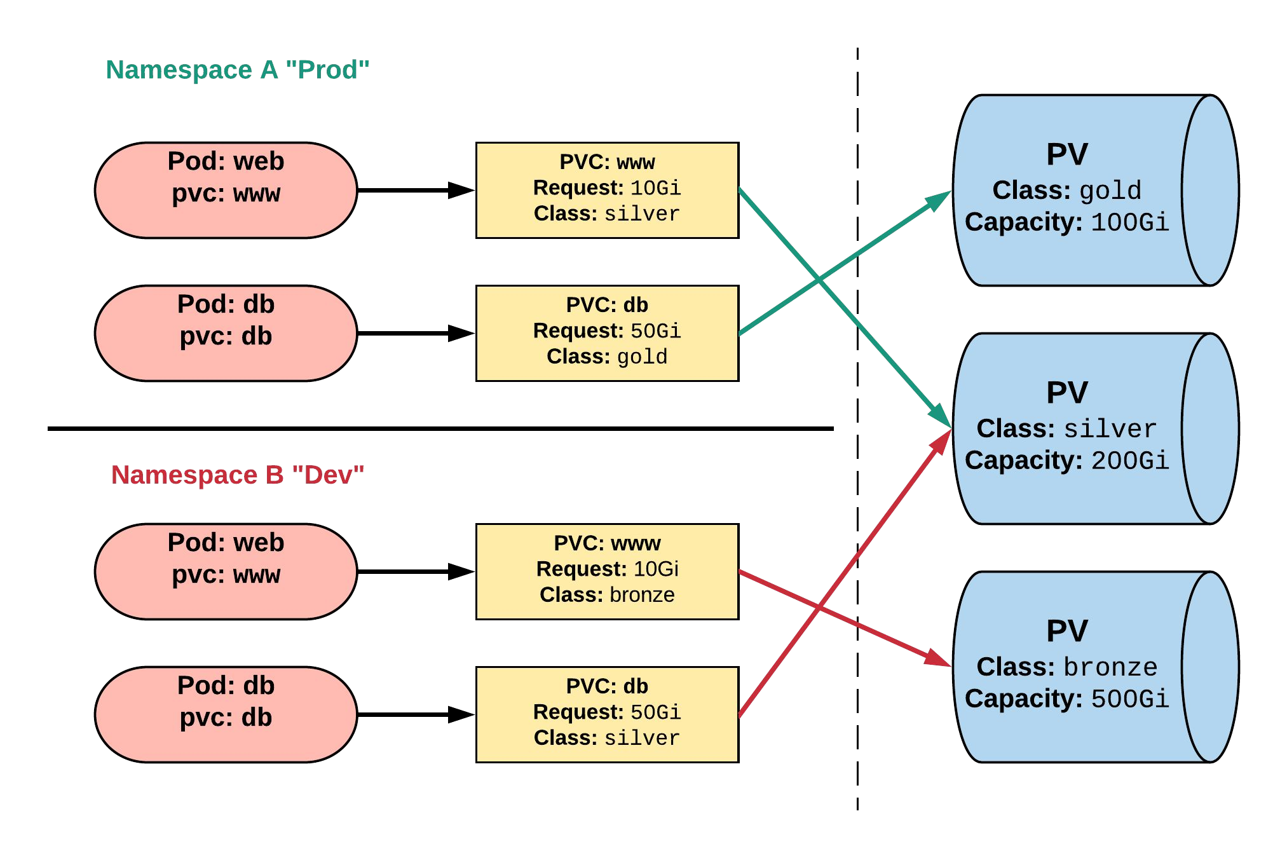
Persistent Volumes and Claims
Cluster Users
Cluster Admins

Slide 120
PersistentVolume
capacity.storage: The total amount of available storage.
volumeMode: The type of volume, this can be either Filesystem or Block.
accessModes: A list of the supported methods of accessing the volume. Options include:
ReadWriteOnce
ReadOnlyMany
ReadWriteMany
apiVersion: v1
kind: PersistentVolume metadata:
name: nfsserver spec:
capacity: storage: 50Gi
volumeMode: Filesystem accessModes:
ReadWriteOnce
ReadWriteMany persistentVolumeReclaimPolicy: Delete storageClassName: slow
mountOptions:
hard
nfsvers=4.1 nfs:
path: /exports server: 172.22.0.42

Slide 121
PersistentVolume
persistentVolumeReclaimPolicy: The behaviour for PVC’s that have been deleted. Options include:
Retain - manual clean-up
Delete - storage asset deleted by provider.
storageClassName: Optional name of the storage class that PVC’s can reference. If provided, ONLY PVC’s referencing the name consume use it.
mountOptions: Optional mount options for the PV.
apiVersion: v1
kind: PersistentVolume metadata:
name: nfsserver spec:
capacity: storage: 50Gi
volumeMode: Filesystem accessModes:
ReadWriteOnce
ReadWriteMany persistentVolumeReclaimPolicy: Delete storageClassName: slow
mountOptions:
hard
nfsvers=4.1 nfs:
path: /exports server: 172.22.0.42

Slide 122
PersistentVolumeClaim
accessModes: The selected method of accessing the storage. This MUST be a subset of what is defined on the target PV or Storage Class.
ReadWriteOnce
ReadOnlyMany
ReadWriteMany
resources.requests.storage: The desired amount of storage for the claim
storageClassName: The name of the desired Storage Class
kind: PersistentVolumeClaim apiVersion: v1
metadata:
name: pvc-sc-example spec:
accessModes:
- ReadWriteOnce resources:
requests: storage: 1Gi
storageClassName: slow

Slide 123
PVs and PVCs with Selectors
kind: PersistentVolume apiVersion: v1 metadata:
name: pv-selector-example labels:
type: hostpath spec:
capacity: storage: 2Gi
accessModes:
- ReadWriteMany hostPath:
path: "/mnt/data"
kind: PersistentVolumeClaim apiVersion: v1
metadata:
name: pvc-selector-example spec:
accessModes:
- ReadWriteMany resources:
requests: storage: 1Gi
selector: matchLabels:
type: hostpath

Slide 124
PVs and PVCs with Selectors
kind: PersistentVolume apiVersion: v1 metadata:
name: pv-selector-example labels:
type: hostpath spec:
capacity: storage: 2Gi
accessModes:
- ReadWriteMany hostPath:
path: "/mnt/data"
kind: PersistentVolumeClaim apiVersion: v1
metadata:
name: pvc-selector-example spec:
accessModes:
- ReadWriteMany resources:
requests: storage: 1Gi
selector:
matchLabels: type: hostpath

Slide 125
PV Phases
Available
PV is ready and available to be consumed.
Bound
The PV has been bound to a claim.
Released
The binding PVC has been deleted, and the PV is pending reclamation.
Failed
An error has been encountered attempting to reclaim the PV.

Slide 126
StorageClass
Storage classes are an abstraction on top of an external storage resource (PV)
Work hand-in-hand with the external storage system to enable dynamic provisioning of storage
Eliminates the need for the cluster admin to pre-provision a PV

Slide 127
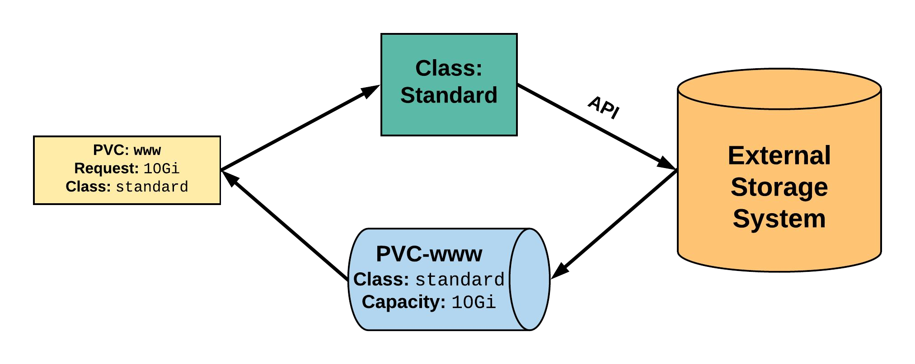
StorageClass
2. StorageClass provisions request through API with
1. PVC makes a request of external storage system. the StorageClass.
uid: 9df65c6e-1a69-11e8-ae10-080027a3682b
4. provisioned PV is bound to requesting PVC.
3. External storage system creates a PV strictly satisfying the PVC request.
pv: pvc-9df65c6e-1a69-11e8-ae10-080027a3682b

Slide 128
StorageClass
provisioner: Defines the ‘driver’ to be used for provisioning of the external storage.
parameters: A hash of the various configuration parameters for the provisioner.
reclaimPolicy: The behaviour for the backing storage when the PVC is deleted.
Retain - manual clean-up
Delete - storage asset deleted by provider
kind: StorageClass apiVersion: storage.k8s.io/v1 metadata:
name: standard
provisioner: kubernetes.io/gce-pd parameters:
type: pd-standard
zones: us-central1-a, us-central1-b reclaimPolicy: Delete

Slide 129
Available StorageClasses
AWSElasticBlockStore
AzureFile
AzureDisk
CephFS
Cinder
FC
FlexVolume
Flocker
GCEPersistentDisk
Glusterfs
Internal Provisioner
iSCSI
PhotonPersistentDisk
Quobyte
NFS
RBD
VsphereVolume
PortworxVolume
ScaleIO
StorageOS
Local

Slide 130
Configuration
ConfigMap
Secret
Concepts and Resources

Slide 131
Configuration
Kubernetes has an integrated pattern for decoupling configuration from application or container.
This pattern makes use of two Kubernetes components: ConfigMaps and Secrets.

Slide 132
ConfigMap
Externalized data stored within kubernetes.
Can be referenced through several different means:
environment variable
a command line argument (via env var)
injected as a file into a volume mount
Can be created from a manifest, literals, directories, or files directly.

Slide 133
ConfigMap
apiVersion: v1 kind: ConfigMap metadata:
name: manifest-example data:
state: Michigan city: Ann Arbor content: |
Look at this, its multiline!
data: Contains key-value pairs of ConfigMap contents.

Slide 134
ConfigMap Example
All produce a ConfigMap with the same content!
apiVersion: v1 kind: ConfigMap metadata:
name: manifest-example data:
city: Ann Arbor state: Michigan
$ kubectl create configmap literal-example \
--from-literal="city=Ann Arbor" --from-literal=state=Michigan
configmap “literal-example” created
$ cat info/city Ann Arbor
$ cat info/state Michigan
$ kubectl create configmap dir-example --from-file=cm/
configmap "dir-example" created
$ cat info/city Ann Arbor
$ cat info/state Michigan
$ kubectl create configmap file-example --from-file=cm/city --from-file=cm/state
configmap "file-example" created

Slide 135
ConfigMap Example
All produce a ConfigMap with the same content!
apiVersion: v1 kind: ConfigMap metadata:
name: manifest-example data:
city: Ann Arbor state: Michigan
$ kubectl create configmap literal-example \
--from-literal="city=Ann Arbor" --from-literal=state=Michigan
configmap “literal-example” created
$ cat info/city Ann Arbor
$ cat info/state Michigan
$ kubectl create configmap dir-example --from-file=cm/
configmap "dir-example" created
$ cat info/city Ann Arbor
$ cat info/state Michigan
$ kubectl create configmap file-example --from-file=cm/city --from-file=cm/state
configmap "file-example" created

Slide 136
ConfigMap Example
All produce a ConfigMap with the same content!
apiVersion: v1 kind: ConfigMap metadata:
name: manifest-example data:
city: Ann Arbor state: Michigan
$ kubectl create configmap literal-example \
--from-literal="city=Ann Arbor" --from-literal=state=Michigan
configmap “literal-example” created
$ cat info/city Ann Arbor
$ cat info/state Michigan
$ kubectl create configmap dir-example configmap "dir-example" created
--from-file=cm/
$ cat info/city Ann Arbor
$ cat info/state Michigan
$ kubectl create configmap file-example --from-file=cm/city --from-file=cm/state
configmap "file-example" created

Slide 137
ConfigMap Example
All produce a ConfigMap with the same content!
apiVersion: v1 kind: ConfigMap metadata:
name: manifest-example data:
city: Ann Arbor state: Michigan
$ kubectl create configmap literal-example \
--from-literal="city=Ann Arbor" --from-literal=state=Michigan
configmap “literal-example” created
$ cat info/city Ann Arbor
$ cat info/state Michigan
$ kubectl create configmap dir-example --from-file=cm/
configmap "dir-example" created
$ cat info/city Ann Arbor
$ cat info/state Michigan
$ kubectl create configmap file-example configmap "file-example" created
--from-file=cm/city --from-file=cm/state

Slide 138
Secret
Functionally identical to a ConfigMap.
Stored as base64 encoded content.
Encrypted at rest within etcd (if configured!).
Ideal for username/passwords, certificates or other sensitive information that should not be stored in a container.
Can be created from a manifest, literals, directories, or from files directly.

Slide 139
Secret
apiVersion: v1 kind: Secret metadata:
name: manifest-secret type: Opaque
data:
username: ZXhhbXBsZQ== password: bXlwYXNzd29yZA==
type: There are three different types of secrets within Kubernetes:
docker-registry - credentials used to authenticate to a container registry
generic/Opaque - literal values from different sources
tls - a certificate based secret
data: Contains key-value pairs of base64 encoded content.

Slide 140
Secret Example
All produce a Secret with the same content!
apiVersion: v1 kind: Secret metadata:
name: manifest-example type: Opaque
data:
username: ZXhhbXBsZQ== password: bXlwYXNzd29yZA==
$ kubectl create secret generic literal-secret \
--from-literal=username=example \
--from-literal=password=mypassword
secret "literal-secret" created
$ cat info/username example
$ cat info/password mypassword
$ kubectl create secret generic dir-secret --from-file=secret/ Secret "file-secret" created
$ cat secret/username example
$ cat secret/password mypassword
$ kubectl create secret generic file-secret --from-file=secret/username --from-file=secret/password
Secret "file-secret" created

Slide 141
Secret Example
All produce a Secret with the same content!
apiVersion: v1 kind: Secret metadata:
name: manifest-example type: Opaque
data:
username: ZXhhbXBsZQ== password: bXlwYXNzd29yZA==
$ kubectl create secret generic literal-secret \
>
>
secret "literal-secret" created
--from-literal=username=example \
--from-literal=password=mypassword
$ cat info/username example
$ cat info/password mypassword
$ kubectl create secret generic dir-secret --from-file=secret/ Secret "file-secret" created
$ cat secret/username example
$ cat secret/password mypassword
$ kubectl create secret generic file-secret --from-file=secret/username --from-file=secret/password
Secret "file-secret" created

Slide 142
Secret Example
All produce a Secret with the same content!
apiVersion: v1 kind: Secret metadata:
name: manifest-example type: Opaque
data:
username: ZXhhbXBsZQ== password: bXlwYXNzd29yZA==
$ kubectl create secret generic literal-secret \
--from-literal=username=example \
--from-literal=password=mypassword
secret "literal-secret" created
$ cat info/username example
$ cat info/password mypassword
$ kubectl create secret generic dir-secret Secret "file-secret" created
--from-file=secret/
$ cat secret/username example
$ cat secret/password mypassword
$ kubectl create secret generic file-secret --from-file=secret/username --from-file=secret/password
Secret "file-secret" created

Slide 143
Secret Example
All produce a Secret with the same content!
apiVersion: v1 kind: Secret metadata:
name: manifest-example type: Opaque
data:
username: ZXhhbXBsZQ== password: bXlwYXNzd29yZA==
$ kubectl create secret generic literal-secret \
--from-literal=username=example \
--from-literal=password=mypassword
secret "literal-secret" created
$ cat info/username example
$ cat info/password mypassword
$ kubectl create secret generic dir-secret --from-file=secret/ Secret "file-secret" created
$ cat secret/username example
$ cat secret/password mypassword
$ kubectl create secret generic file-secret Secret "file-secret" created
--from-file=secret/username --from-file=secret/password

Slide 144
Injecting as Environment Variable
apiVersion: batch/v1 kind: Job
metadata:
name: cm-env-example spec:
template: spec:
containers:
- name: mypod
image: alpine:latest command: [“/bin/sh”, “-c”] args: [“printenv CITY”] env:
- name: CITY valueFrom:
configMapKeyRef:
name: manifest-example key: city
restartPolicy: Never
apiVersion: batch/v1 kind: Job
metadata:
name: secret-env-example spec:
template: spec:
containers:
- name: mypod
image: alpine:latest command: [“/bin/sh”, “-c”] args: [“printenv USERNAME”] env:
- name: USERNAME
valueFrom: secretKeyRef:
name: manifest-example key: username
restartPolicy: Never

Slide 145
Injecting in a Command
apiVersion: batch/v1 kind: Job
metadata:
name: cm-cmd-example spec:
template: spec:
containers:
- name: mypod
image: alpine:latest command: [“/bin/sh”, “-c”]
args: [“echo Hello ${CITY}!”] env:
- name: CITY valueFrom:
configMapKeyRef:
name: manifest-example key: city
restartPolicy: Never
apiVersion: batch/v1 kind: Job
metadata:
name: secret-cmd-example spec:
template: spec:
containers:
- name: mypod
image: alpine:latest command: [“/bin/sh”, “-c”]
args: [“echo Hello ${USERNAME}!”] env:
- name: USERNAME
valueFrom: secretKeyRef:
name: manifest-example key: username
restartPolicy: Never

Slide 146
Injecting as a Volume
apiVersion: batch/v1 kind: Job
metadata:
name: cm-vol-example spec:
template: spec:
containers:
name: mypod
image: alpine:latest command: [“/bin/sh”, “-c”] args: [“cat /myconfig/city”] volumeMounts:
- name: config-volume mountPath: /myconfig
restartPolicy: Never volumes:
name: config-volume configMap:
name: manifest-example
apiVersion: batch/v1 kind: Job
metadata:
name: secret-vol-example spec:
template: spec:
containers:
name: mypod
image: alpine:latest command: [“/bin/sh”, “-c”]
args: [“cat /mysecret/username”] volumeMounts:
- name: secret-volume mountPath: /mysecret
restartPolicy: Never volumes:
name: secret-volume secret:
secretName: manifest-example

Slide 147
SIGs
Kubernetes components and features are broken down into smaller self-managed communities known as Special Interest Groups (SIG).
Hold weekly public recorded meetings and have their own mailing lists and slack channels.

Slide 148
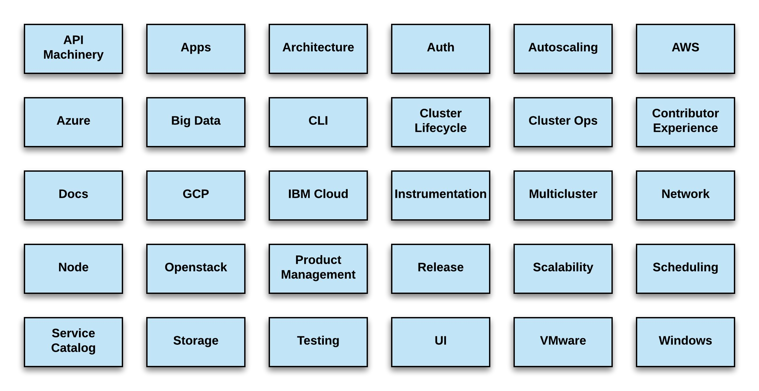
SIG List
https://github.com/kubernetes/community/blob/master/sig-list.md
5/21/2018

Slide 149
Working Groups
Similar to SIGs, but are topic focused, time-bounded, or act as a focal point for cross-sig coordination.
Hold scheduled publicly recorded meetings in addition to having their own mailing lists and slack channels.

Slide 150
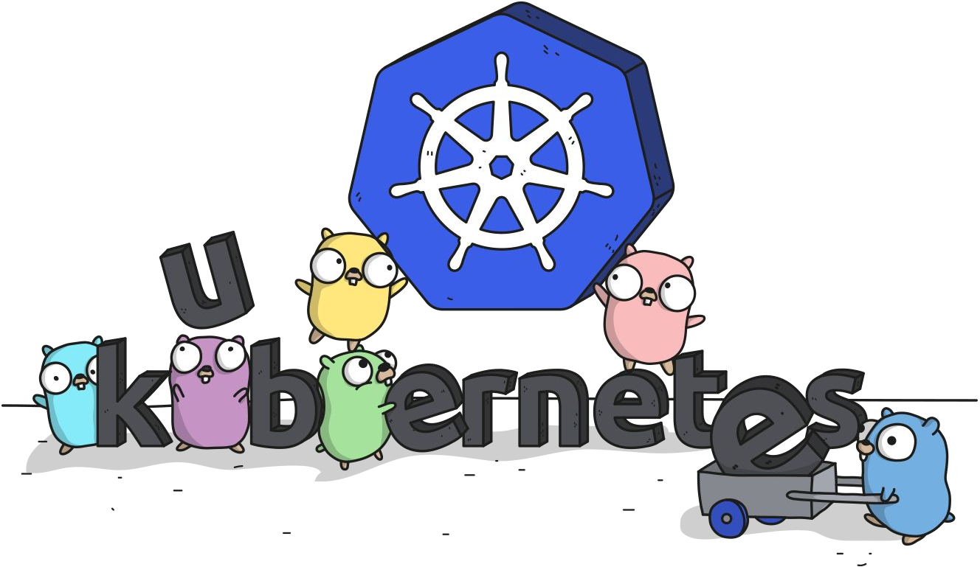
Links
Free Kubernetes Courses
https://www.edx.org/
Interactive Kubernetes Tutorials
https://www.katacoda.com/courses/kubernetes
Learn Kubernetes the Hard Way
https://github.com/kelseyhightower/kubernetes-the-hard-way
Official Kubernetes Youtube Channel
https://www.youtube.com/c/KubernetesCommunity
Official CNCF Youtube Channel
https://www.youtube.com/c/cloudnativefdn
Track to becoming a CKA/CKAD (Certified Kubernetes Administrator/Application Developer)
https://www.cncf.io/certification/expert/
Awesome Kubernetes
https://www.gitbook.com/book/ramitsurana/awesome-kubernetes/details

